Slide 1
TLS: avoiding dangers
A presentation by Dmitry Belyavsky, TCI
Business Internet Conference
Kiev, Ukraine, December 2013

Slide 2
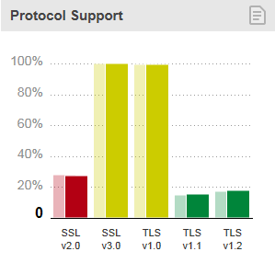
TLS: history
SSLv2 deprecated by RFC 6176
SSLv3 still widely supported
TLS 1.0 in RFC 2246 (1999)
TLS 1.1 in RFC 4346 (2006)
TLS 1.2 in RFC 5246 (2008)

Slide 3
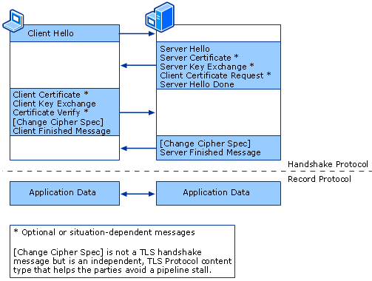
TLS: general overview

Slide 4
Check the server certificate
The server certificate signed correctly by any of them?
Many trusted
CAs
NO
YES
We warn the user
Everything seems to be ok!

Slide 5
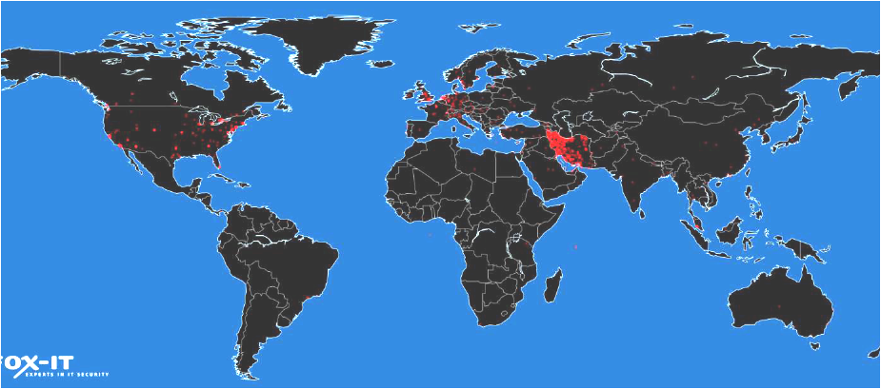
DigiNotar case
OCSP requests for the fake *.google.com certificate
Source: FOX-IT, Interim Report, http://cryptome.org/0005/diginotar-insec.pdf

Slide 6
PKI: extra trust
PKI
Independent source
Trusted certificate
DANE (RFC 6698)
Limited browsers support
Certificate pinning
Mozilla Certificate Patrol,
Chrome cache for Google certificates
Certificate transparency (RFC 6962)
Inspired by Google (Support in Chrome appeared)
One of the authors - Ben Laurie (OpenSSL Founder)
CA support – Comodo

Slide 7
Secret key size
Factorization
576 bit 2003
640 bit 2005
768 bit 2009
RSA
Use >= 2048 bit keys now
Patent Restrictions
Elliptic curve cryptography

Slide 8
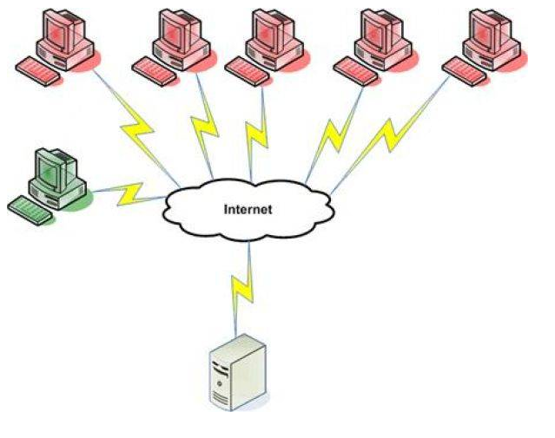
RSA key exchange
Private key
Public key
So it can be decrypted when the attacker gets the server private key
Premaster secret in encrypted on server public key and sent to server

Slide 9
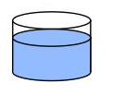
Perfect Forward Secrecy
ALICE
+
=
+
=
Common Paint
Secret Colours
Public Transport
Secret Colours
Common Secret
+
=
+
=
BOB
SSL Best Practices
https://www.ssllabs.com/projects/best-practices/

Slide 10
TLS encryption
Block Ciphers
3DES, DES, MD2…
AES 128/192/256
Camellia 128/192/256
BEAST
Lucky 13
Stream Ciphers
RC4
No BEAST attack
Key recovery attacks

Slide 11
Recommendations - I
Anonymous Difﬁe-Hellman (ADH) suites do not provide authentication
NULL cipher suites provide no encryption
Export key exchange suites use authentication that can easily be broken
Suites with weak ciphers (typically of 40 and 56 bits) use encryption that can easily be broken
X
X
X
X

Slide 12
Recommendations - II
SSLProtocol all -SSLv2 -SSLv3
SSLHonorCipherOrder on
SSLCipherSuite
EECDH+ECDSA+AESGCM
EECDH+aRSA+AESGCM
EECDH+ECDSA+SHA384
EECDH+ECDSA+SHA256
EECDH+aRSA+SHA384
EECDH+aRSA+SHA256
EECDH+aRSA+RC4
EECDH EDH+aRSA
RC4 !aNULL !eNULL !LOW !3DES !MD5 !EXP !PSK !SRP !DSS”

Slide 13
Q&A
Questions?
Drop ‘em at:
beldmit@tcinet.ru

