Slide 1
DNS Privacy: Problem and solutions
A presentation by Dmitry Belyavsky, TCI
EE DNS Forum / UADOM
Kyiv, December 1, 2016

Slide 2
Age of privacy
Internet has changed the world
What is privacy now?
Personal data
Metadata (Whom did you contact to?)
Cookies, web-counters…
Nation-wide eavesdroppers
Protecting privacy
Safe protocols:
HTTPS, IMAPS, SFTP, SSH…
All but DNS!

Slide 3
Problem with DNS
DNS – very old protocol
Is DNS Data sensitive?
DNSSec does not protect data exchange from monitoring
Send as little data as possible!
Encrypt it!

Slide 4
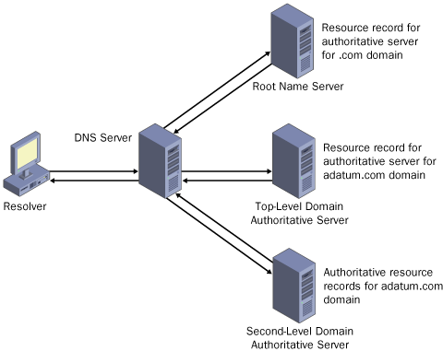
Normal resolving process

Slide 5
DNS Privacy: history
Initiated by Stephane Bortzmeyer (2013)
IETF working group dprive (2014) https://datatracker.ietf.org/wg/dprive
Threat model: RFC 7626 (2015)
QNAME minimization: RFC 7816 (2016)
EDNS(0) Padding Option: RFC 7830 (2016)
DNS over TLS: RFC 7858 (2016)

Slide 6
DNS Privacy: Threat model
Described in RFC 7626
DNS data is public,
Your DNS request is NOT Public
QNAME
Source IP
DNS and data routing may differ
DNS requests are not encrypted
Up to 70% of users can be recognized by their queries.

Slide 7
DNS Privacy: QNAME minimization
Described in RFC 7816 (Experimental)
If you want to access l5.l4.l3.example.com,
root DNS servers can answer about .com
.com – about example.com
…
No extra privacy leaks
May increase or reduce number of requests
Problems with some CDNs – to be fixed
Supported in
Knot Resolver 1.0+
Unbound 1.5.7+

Slide 8
DNS Privacy: DNS over (D)TLS
Described in RFC 7858
TCP: DNS over TLS
UDP: DNS over DTLS
Port 853
Implemented in
Unbound 1.4.7+ - server
Getdns – client
Go library

Slide 9
DNS Privacy + DNSSEC
Whom do we trust?
Trusted certs
Opportunistic security
TLS Hello extension
Request: DNSSEC Chain Ext
Response: Server DANE records
Specification: https://datatracker.ietf.org/doc/draft-ietf-tls-dnssec-chain-extension/

Slide 10
DNS Privacy: How to test
Servers: Sinodun, DNS-OARC
https://portal.sinodun.com/wiki/display/TDNS/DNS-over-TLS+test+servers
https://www.dns-oarc.net/oarc/services/dnsprivacy
Stub resolvers: GetDNS Stubby
https://getdnsapi.net

Slide 11
Related technologies: DNSCrypt
No RFC, https://dnscrypt.org/
Protects communication between client and resolver
443 port, both TCP/UDP
Implemented in many routers and Yandex.browser (port 15353)

Slide 12
DNS Privacy: conclusions
There are all the necessary standards
It’s time to switch them on

Slide 13
Q&A
Questions?
Drop ‘em at:
beldmit@tcinet.ru

