Slide 1
Security, Internet of Things, DNS and ICANN
ICANN Security Team |Kiev | November 29-30 2016

Slide 2
Agenda
What is the Internet of Things?
IOT device characteristics and challenges
Threat landscape
Is the past a prelude to the future?

Slide 3
What is the Internet of Things?
IoT (Internet of Things) is about connecting the next wave of devices to the Internet.
A universe of devices that may be present in all aspects of lifestyle, health, or society
These devices are locally and globally connected via Internet services

Slide 4
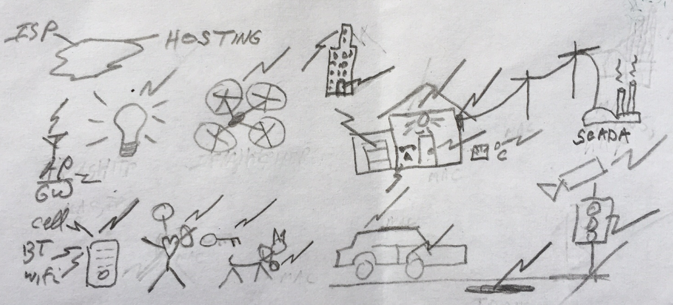
IoT on a Bar Napkin

Slide 5
Characteristics of IoT Devices
Very large to unimaginable number of devices
“Things” encompasses virtually any thing that might be automated or expected to collect or report information
Devices are small or embedded in things or beings
Initial wave have limited processor, memory, or power constraints
Machine to machine communication is typically more common than human to machine communication
Like all preceding waves, security and privacy are at odds with the desired pace to commoditize

Slide 6
Machine to Machine communications: The loss of the “human factor”
IOT will change communication patterns:
- Not limited to “eye-ball” bandwidth
➔ Potentially infinite aggregated bandwidth
- Not limited to human work/home/sleep patterns
➔ Changes to daily/weekly traffic patterns

Slide 7
Retail cost is a key driver
Impacts?
Will we see new “streamlined” protocols?
Custom operating systems?
We have been here before
Remember WAP versus HTML markup in early mobile devices?
Race conditions:
Pace of development or adoption of new protocols versus pace of device hardware improvements

Slide 8
Threat landscape
Devices may increasingly control traditionally human-directed activities at much larger scales than ever before
Autonomous vehicles
Aviation
Package or other forms of delivery
Residential or business environmental control systems
Devices may increasingly become “part of us”
They may assist with human bio-functions
They may store significant or critical health data
There may be no human to detect or respond to malfunction
Things could break and go undetected until a security event

Slide 9
Past is Prelude…
History shows that we introduce new attack vectors with new waves:
New/custom OSs, streamlined protocols, apps
Modifications to streamline general purpose operating systems
New generation of developers that are unfamiliar with historical vulnerabilities
Inherited problems of lax configuration defaults

Slide 10
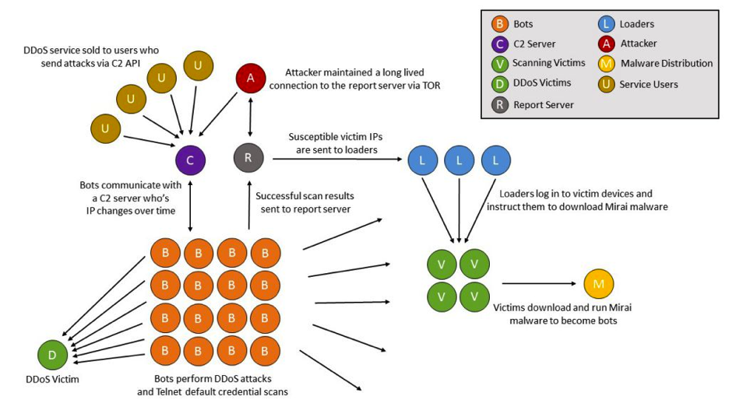
Some threats have been realized…
“Vulnerable IoT devices are subsumed into the Mirai botnet by continuous, automated scanning for and exploitation of well-known, hardcoded administrative credentials present in the relevant IoT devices. These vulnerable embedded systems are typically listening for inbound telnet access on TCP/23 and TCP/2323.” Roland Dobbins, Arbor Networks
http://blog.level3.com/security/grinch-stole-iot/ https://www.arbornetworks.com/blog/asert/mirai-iot-botnet-description-ddos-attack-mitigation/

Slide 11
What warning bells does Mirai ring for us all
Mirai encapsulates many IoT security issues
A botnet is largely comprised of IoT devices
The compromised devices use plain text channels that have long been regarded as unsecured and removed from use in current wave of products
The default credentials for these services are known and shared
The devices can be re-purposed for many kinds of attacks
An IoT-populated botnet takes DDOS as a service to another level

Slide 12
Building IoT devices
Re-purpose general purpose OSs or build a custom OS from scratch?
Can you effectively and correctly prune services or binaries that attackers can exploit?
Or
Can you securely code a custom OS and improve the security baseline for IoT devices

Slide 13
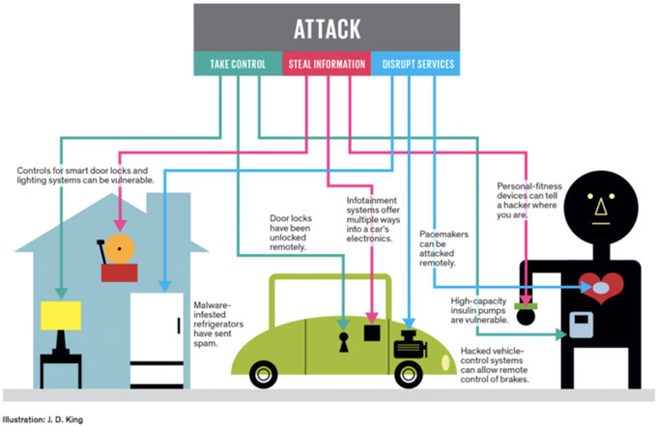
Historically, lowest cost solution wins… and security?
https://blog.equinix.com/blog/2015/10/16/security-challenges-in-the-iot-era-internet-things-coming-together/

Slide 14
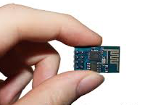
Building IoT devices
Build or re-purpose hardware?
Use chips tailored to be just what is needed
Or use
Mass-produced, high-capacity chipsets (that provide more capable attack delivery systems)

Slide 15
Once you build them…
How do you continue to secure them?
History shows that commodity devices
Are not routinely upgraded or patched
Are not always managed according to best practices
Commodity devices also are saddled with the “shelf life” problem
Units may occupy shelves in stores for months or years
Multiple versions of firmware or software may be in the field
Vendors may not offer consumer managable upgrade methods
Mirai suggests that IoT devices will follow same path

Slide 16
Retail cost objectives conflict with security objectives
Secure or confidential communication protocols may be incompatible with memory or CPU footprint. This affects
Cost of device
Development cost
Desired time to market window of manufacturers
Persistently strong incentives to collect metadata or personal identifying information
Cost of implementing authorization (e.g., data permissions)
Incentives to provide data to third parties for fee
Is anyone considering data protection on devices?

Slide 17
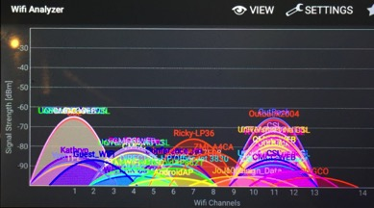
IoT by the numbers, identifiers, protocols
Spectrum ..13.56MHz, 900MHz, 2.4/5GHz, 24GHz… (GOVTs/ITU)
Modulation, Media Access Control, e.g. bluetooth, wifi, zigbee,.. (IG/IEEE)
MAC addresses, e.g., 00:20:68:12:BE:EF/ISDYNE (IEEE)
Other numbers: ports: 80/HTTP, 443/HTTPS, 161/SNMP, OID/PEN: 1.3.6.1.4.1.2011/Huawei (IETF/ICANN)
IPv4, IPv6: 199.7.83.42, 2001:500:9f::42 (RIR/ICANN)
ASN: AS2706/Wharf TT… (RIR/ICANN)
Domain Names: www.co.tt … (ICANN)
HTTP, SMTP, SIP, XMPP, RTP, app specific… (IETF/ITU/IG)
Security: SSL/TLS, RSA, ECC, AES, … (Academia/IG/IETF/GOVTs)
Notes:
IoT is a reason for IPv6, i,.e., IPv6lopan

Slide 18
Very large quantity of devices Next orders of magnitude
Tens of billions of smart devices by 2020
Gartner, McKinsey, Cisco, Ericsson
Even if each sends small amounts of traffic...
Addressing considerations:
NAT still? Forcing function to IPv6?
Most device communications are local to a home LAN
Traffic to the outside goes through a controler
Still, very different scale of NAT
What about naming devices? Other identifiers?

Slide 19
DNSSEC and IoT
Security is a well known missing piece for IoT
Many IoT applications have physical world safety implications
human harm, disruption of critical infrastructure service delivery
Can we use an existing infrastructure to enable a secure, global, cross-organizational, trans-national communication channel between devices?
Specifically, can we use DNSSEC for key distribution necessary to secure channels and then securely bootstrap application specific security mechanisms?
Can DNS with DNSSEC solve this problem?
For example, can we use DANE to publish public keys in the DNS, so that end user can validate keys using DNSSEC?
Notes:
Holy grail of true end-2-end security. Makes some nervous. German ISPs have embraced DANE.
This is a recognized issue but businesses are too busy focusing forward.
This will be an issue and is therefore an opportunity for those looking ahead with skills.
BTW: That IoT light bulb is connected to the same home network on which you do your banking transactions…hmmm.

Slide 20
Can DNS provide a foundation for scalable security
root
DNS is already present
DNSSEC adds security
com
and crosses organizational boundaries.
google.com
za
co.za
security.co.za
electric.co.za
iotdevices.co.za
water.rickshome.security.co.za
car.rickshome.iotdevices.co.za
aircond.rickshome.electric.co.za
window.rickshome.security.co.za
thermostat.rickshome.iotdevices.co.za
meter.rickshome.electric.co.za
door.rickshome.security.co.za
refrigerator.rickshome.iotdevices.co.za
Animated slide
Notes:
An opportunity to build security into IoT devices from the start.

Slide 21
Summary
The Internet of Things holds great promise
If we allow history to repeat,
➔ it can also pose a great threat
Is Must the past (be) a prelude to the future?
➔ if not, who can influence the market and how?

Slide 22
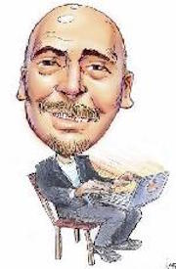
Questions?
Contacts: email: dave.piscitello@icann.org twitter: @securityskeptic
web: securityskeptic.com
company: icann.org
ICANN Security Team: icann.org/resources/pages/security-2012-02-25-en
11/30/16
22

