Slide 1
ICANN’s Policy Development Activities
EE DNS Forum
David Olive, SVP Policy Development Support
1-2 December 2016 – Kiev

Slide 2
What is ICANN?
Global, multistakeholder organization that coordinates the Internet’s system of unique identifiers—domain names, IP addresses and Internet Protocols—enabling a single, interoperable Internet.
Dedicated to preserving operational stability of the Internet, promoting competition, through broad representation in a bottom-up, consensus-based process.

Slide 3
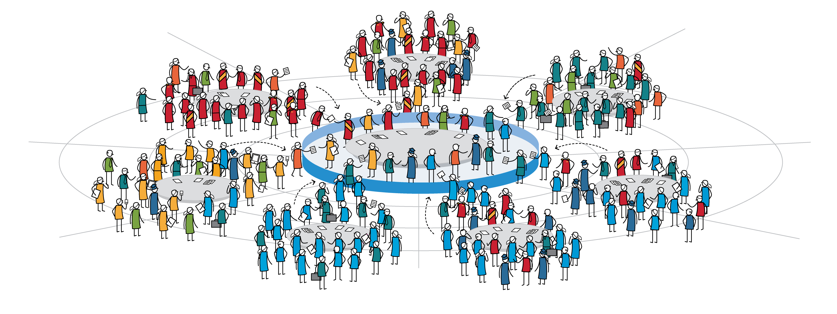
The ICANN Community At Work – Policy / Advice Development
The Bottom-Up Multistakeholder Model
The collective efforts of the ICANN community culminate in a common shared goal:
A single, interoperable Internet supported by stable, secure and resilient unique identifier systems
Country Codes Names Supporting Organization
Government
Advisory Committee
Generic Names Supporting Organization
POLICY / ADVICE
At-Large
Advisory Committee
Root Server System
Advisory Committee
Address Supporting Organization
Security & Stability
Advisory Committee
Business
Government & Governmental Organizations
Civil Society
Domain Name
Industry
Internet Users
Academic
Technical

Slide 4
Policy Development
A primary role of ICANN is to coordinate policy development related to the global Internet’s systems of unique identifiers.
ICANN’s open and transparent policy development mechanisms promote well-informed decisions based on expert advice from a diversity of views from globally diverse stakeholders.
The ICANN Community works to improve and streamline these mechanisms so as many global stakeholders as possible can have participate and have their voices heard.
The bottom up, consensus approach results in recommendations for the domain name system (DNS) that are fair, effective, and carefully considered, preserving and enhancing the security, stability and resiliency of the Internet.

Slide 5
Policy Development: Who?
ICANN Supporting Organizations (SO)
Address Supporting Organization—ASO
Country Code Names Supporting Organization—ccNSO
Generic Names Supporting Organization—GNSO
ICANN Advisory Committees (AC)
At-Large Advisory Committee (ALAC)
Governmental Advisory Committee (GAC)
Root Server System Advisory Committee (RSSAC)
Security and Stability Advisory Committee (SSAC)

Slide 6
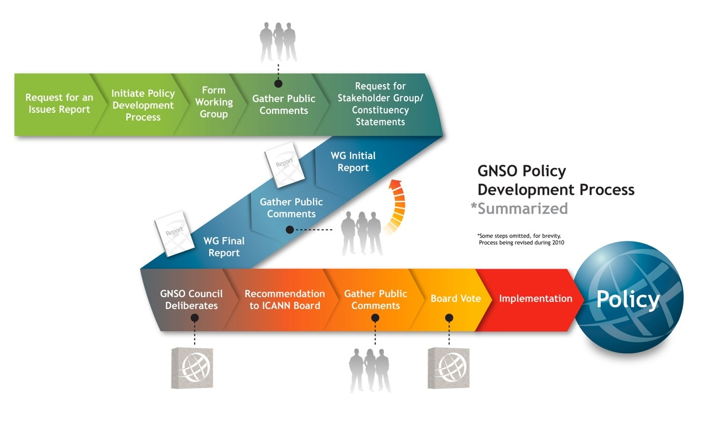

Slide 7
Consensus Policies
The following policies are specifically identified as having been adopted as consensus policies by the ICANN Board of Directors:
Uniform Domain Name Dispute Resolution Policy (adopted by ICANN Board 26 August 1999; form of implementation documents approved 24 October 1999).
Whois Data Reminder Policy (adopted by ICANN Board 27 March 2003)
Inter-Registrar Transfer Policy (effective 1 June 2012).
Whois Marketing Restriction Policy (adopted by ICANN Board 27 March 2003)
Restored Names Accuracy Policy (adopted by ICANN Board 27 March 2003).
Expired Domain Deletion Policy (adopted by ICANN Board 31 October 2003).
Registry Services Evaluation Policy (adopted by ICANN Board 8 November 2005)
AGP Limits Policy (adopted by ICANN Board on 26 June 2008)
Expired Registration Recovery Policy (adopted by ICANN Board on 28 October 2011)
Additional Whois Information Policy (adopted by ICANN Board 6 May 2012)
In 2008, the ICANN Board adopted 19 specific GNSO policy recommendations for implementing new gTLDs.

Slide 8
Rights Protection Mechanisms at ICANN
The question of who legally has rights to, or is the legitimate holder of, a domain name can be open to dispute. In relation to domain name disputes concerning the registration and use of legally protected trademarks, the Uniform Dispute Resolution Policy (UDRP) is the longest standing alternative dispute resolution procedure.
The WIPO Arbitration and Mediation Center is internationally recognized as the leading institution in the resolution of Internet domain name disputes. Since December 1999, the Center has administered over 31,000 proceedings, primarily in the generic Top Level Domains (gTLDs)
With the WIPO ccTLD Program in 2000, WIPO has provided advice to many ccTLDs on dispute resolution procedures that conform with international standards of intellectual property protection while taking into account the particular circumstances and needs of the individual ccTLD.

Slide 9
Rights Protection Mechanisms at ICANN
As a result of the New gTLD Program, several new rights protection mechanisms (RPMs) were developed to mitigate potential risks and costs to trademark rights holders that could arise in the expansion of the gTLD namespace:
a. The Trademark Clearinghouse (TMCH), which authenticates global rights information, maintains a centralized database of these, and provides this information to registries and registrars during the domain name registration process in all gTLDs launched under the New gTLD Program. Verified data from the TMCH supports the additional protective mechanisms available during the Sunrise and Trademark Claims service periods.
b. The Uniform Rapid Suspension System (URS), which is modeled on the UDRP and aims to provide a trademark holder with a fast and reasonably inexpensive way to obtain the suspension of a domain name that was registered and used in bad faith.
c. The Post-Delegation Dispute Resolution Procedures (PDDRPs) , which provide alternative avenues for a trademark holder who is harmed by a new gTLD registry operator’s conduct to obtain redress.

Slide 11
Policy Issues Discussed in the GNSO

Slide 12
Rights Protection Mechanisms at ICANN
GNSO Policy Development Process
The review of all Rights Protection Mechanisms (RPMs) in all generic top-level domains (gTLDs) is being conducted in two phases.
Phase One will review all RPMs applicable to gTLDs launched under the
2012 New gTLD Program, namely the Uniform Rapid
Suspension Procedure (URS), the Trademark Post-Delegation Dispute Resolution Procedures (PDDRP), and the Trademark Clearinghouse (TMCH), verified data of which supports additional protection mechanisms available during the Sunrise and Trademark Claims service periods.
Phase Two will review the Uniform Dispute Resolution Policy (UDRP), which has been an ICANN Consensus Policy since 1999.
The PDP Working Group is open to all, who may join. Please email the GNSO Secretariat at gnso-secs@icann.org
.

Slide 13
ICANN Presentation – EE DNS Forum
David Olive, SVP Policy Development Support
1-2 December 2016 – Kiev

