Slide 1
An Introduction to Universal Acceptance
Presenter Name / Event Name / DD Month YYYY

Slide 2
UA in a Nutshell
Universal Acceptance (UA) ensures that all domain names and email addresses can be used by all Internet-enabled applications, devices and systems.

Slide 3
Anatomy of an email address
username@example.com
测试5@普遍接受-测试.世界
Username/ 测试5
Mailbox name
Can be in ASCII or Unicode
Second level domain name (example/ 普遍接受-测试)
Can be ASCII or Unicode.
Unicode can be represented as Unicode or Punycode
Top Level Domain name (.com/.世界)
Can be ASCII or Unicode
Unicode can be represented as Unicode or Punycode
Can be 2 to 63 characters long
Can ONLY be from an authoritative list that is dynamic and has more than 1,000 choices

Slide 4
Five Verbs to UA Readiness
Accept
Validate
Store
Process
Display

Slide 5
Our Target Audiences
Doers
Developers & Systems Architects
Directors
CIOs and senior IT Management
Influencers
C* suite, Thought Leaders, Government Ministers and Officials

Slide 6
Why Bother
Enablement for culture, society and economics
Responsibility to comply with standards
UA results in better User eXperience (UX)

Slide 7
Principles of Universal Acceptance

Slide 8
Accept
UASG Recommendations
User interface elements must support:
Unicode.
Strings up to 256 characters.
ASCII Compatible Encoded text (“Punycoded”) in place of Unicode.
Unicode shown by default.
Punycoded text shown only when it provides a benefit.
The process by which an email address or domain name is received as a string of characters from a user interface, file or API.
Notes:
UASG Recommendations
User interface elements requiring user to type domain name/email address must support Unicode and strings up to 256 characters
Users should be allowed to enter ASCII Compatible Encoded text (“Punycoded”) in place of Unicode equivalent
Unicode should be shown by default
Punycoded text should only be shown when provides a benefit

Slide 9
Validate
UASG Recommendations
Easiest way to ensure all valid domain names are accepted.
Should not occur unless required. If yes:
Verify TLD against authoritative table.
Query domain name against DNS.
Require repeated entry of email address.
Validate characters - no “disallowed” code points.
Limit to few, whole-label rules defined in RFCs
If string contains ‘。’ convert to ‘.’
The process by which an email address or domain name – received or emitted – is checked for syntax correctness.
Notes:
Many programmers have been trained to validate by following heuristics that require checking that a top-level domain has the “correct” number of letters, or that the letters are from the ASCII character set. These heuristics are no longer applicable because of the introduction of domain names with more than three characters, and Unicode (non-ASCII) characters.

Slide 10
Store
UASG Recommendations
Apps / services should support Unicode
Information stored in UTF-8 whenever possible
Consider end-to-end scenarios before converting between A-Labels & U-Labels
Consider storing in both formats
Clearly mark email addresses and domain names during storage
The long-term and / or transient storage of domain names and email addresses.
Notes:
Regardless of the lifetime of the data, it should be stored in RFC-defined formats (preferred) or other formats which can transform between RFC-defined formats.
UTF-8 (Unicode Transformation Format). Some systems may require support for UTF-16 as well, but generally UTF-8 is preferred. UTF-7 and UTF-32 should be avoided.
Consider all end-to-end scenarios before converting A-Labels to U-Labels and vice versa when storing. It may be desirable to maintain only U-Labels in a file or database, because it simplifies searching and sorting. However, conversion may have implications when interoperating with older, non-Unicode-enabled applications and services. Consider storing in both formats.
Instances where email addresses and domain names have been filed under the “author” field of a document or “contact info” in a log file have led to the loss of origin as an address.

Slide 11
Process
UASG Recommendations
Check code points not defined when application / service was created – shouldn’t “break” user experience.
Use supported Unicode-enabled APIs.
Use latest IDNA Protocol & Tables documents for Internationalized Domain Names.
Process in UTF-8 wherever possible.
Occurs whenever an email address or domain name is used by an application or service to perform an activity, or is transformed into an alternate format.
Notes:
Activity (e.g., searching or sorting a list)
Alternate format (e.g., storing ASCII as Unicode).
Additional validation may also occur during processing. Domain names and email addresses can be processed in an unlimited number of ways*, which reinforces the need for conventions that ensure data is being understood and classified consistently. *Examples: Identify people in New Zealand by searching within the .nz ccTLD; identify pharmacists by searching for user@*.pharmacist email addresses.
Recommendations:
Since the Unicode standard is continually expanding, code points not defined when the application or service was created should be checked to ensure they will not “break” the user experience. Missing fonts in the underlying operating system may result in non-displayable characters (frequently the “” character is used to represent these), but this situation should not result in a fatal crash.
Use supported Unicode-enabled APIs.
Use the latest Internationalized Domain Names in Applications (IDNA) Protocol [http://tools.ietf.org/html/rfc5891] and Tables [http://tools.ietf.org/html/rfc5892] documents for Internationalized Domain Names (IDNs).
Process in UTF-8 format wherever possible.
Ensure that the product or feature handles numbers as expected. For example, ASCII numerals and Asian ideographic number representations should be treated as numbers. [RFC5892, link above]
Upgrade applications and servers/services together. If the server is Unicode and client is non-Unicode or vice versa, the data will need to be converted to each code page every time the data travels between server and client.
Perform code reviews to avoid buffer overflow attacks. When doing character transformation, text strings may grow or shrink substantially.

Slide 12
Process (continued)
UASG Recommendations
Ensure numbers are handled as expected
Treat ASCII numerals & Asian ideographic number representations as numbers
Upgrade apps & servers/services together
Perform code reviews to avoid buffer overflow attacks
Occurs whenever an email address or domain name is used by an application or service to perform an activity, or is transformed into an alternate format.
Notes:
Activity (e.g., searching or sorting a list)
Alternate format (e.g., storing ASCII as Unicode).
Additional validation may also occur during processing. Domain names and email addresses can be processed in an unlimited number of ways*, which reinforces the need for conventions that ensure data is being understood and classified consistently. *Examples: Identify people in New Zealand by searching within the .nz ccTLD; identify pharmacists by searching for user@*.pharmacist email addresses.
Recommendations:
Since the Unicode standard is continually expanding, code points not defined when the application or service was created should be checked to ensure they will not “break” the user experience. Missing fonts in the underlying operating system may result in non-displayable characters (frequently the “” character is used to represent these), but this situation should not result in a fatal crash.
Use supported Unicode-enabled APIs.
Use the latest Internationalized Domain Names in Applications (IDNA) Protocol [http://tools.ietf.org/html/rfc5891] and Tables [http://tools.ietf.org/html/rfc5892] documents for Internationalized Domain Names (IDNs).
Process in UTF-8 format wherever possible.
Ensure that the product or feature handles numbers as expected. For example, ASCII numerals and Asian ideographic number representations should be treated as numbers. [RFC5892, link above]
Upgrade applications and servers/services together. If the server is Unicode and client is non-Unicode or vice versa, the data will need to be converted to each code page every time the data travels between server and client.
Perform code reviews to avoid buffer overflow attacks. When doing character transformation, text strings may grow or shrink substantially.

Slide 13
Display
UASG Recommendations
Display all Unicode code points supported by underlying operating system.
When developing app/service, or operating a registry, consider languages supported.
Convert non-Unicode data to Unicode before display.
End user should see “everyone.みんな” vs. “everyone.xn--q9jyb4c.”
Display occurs whenever an email address or a domain name is rendered within a user interface.
Notes:
Displaying domain names and email addresses is usually straightforward when the scripts used are supported in the underlying OS and strings are stored in Unicode; however, application-specific transformations may be required otherwise.
Recommendations
Display all Unicode code points which are supported by the underlying operating system. If an application maintains its own font sets, comprehensive Unicode support should be offered to the collection of fonts available from the operating system.
When developing an app or a service, or when operating a registry, consider the languages supported and make sure OS and applications cover those languages.
Convert non-Unicode data to Unicode before display. For example, the end user should see “everyone.みんな” as opposed to “everyone.xn--q9jyb4c”. (This conversion is an example of UA-ready processing).
Display Unicode by default. Use Punycoded text to the user only when it provides a benefit. Augment Unicode display with Punycoded hover text as a mitigation.
Consider that mixed-script addresses will become more common. Some Unicode characters may look the same to the human eye, but different to computers. Don’t assume that mixed-script strings are intended for malicious purposes, such as phishing, and if the user interface calls the strings to the user’s attention, be sure that it does so in a way which is not
prejudicial to users of non-Latin scripts. Learn more about Unicode Security Considerations at: http://unicode.org/reports/tr36/.
Use Unicode IDNA Compatibility Processing in order to match user expectations. To learn more, go to: http://unicode.org/reports/tr46/.
Be aware of unassigned and disallowed characters. Learn more at RFC 5892: https://tools.ietf.org/rfc/rfc5892.txt.

Slide 14
Display (continued)
UASG Recommendations
Display Unicode by default
Use Punycoded text only when it provides a benefit
Consider that mixed-script addresses will become more common
Use Unicode IDNA Compatibility Processing to match user expectations
Be aware of unassigned & disallowed characters
Display occurs whenever an email address or a domain name is rendered within a user interface.
Notes:
Displaying domain names and email addresses is usually straightforward when the scripts used are supported in the underlying OS and strings are stored in Unicode; however, application-specific transformations may be required otherwise.
Recommendations
Display all Unicode code points which are supported by the underlying operating system. If an application maintains its own font sets, comprehensive Unicode support should be offered to the collection of fonts available from the operating system.
When developing an app or a service, or when operating a registry, consider the languages supported and make sure OS and applications cover those languages.
Convert non-Unicode data to Unicode before display. For example, the end user should see “everyone.みんな” as opposed to “everyone.xn--q9jyb4c”. (This conversion is an example of UA-ready processing).
Display Unicode by default. Use Punycoded text to the user only when it provides a benefit. Augment Unicode display with Punycoded hover text as a mitigation.
Consider that mixed-script addresses will become more common. Some Unicode characters may look the same to the human eye, but different to computers. Don’t assume that mixed-script strings are intended for malicious purposes, such as phishing, and if the user interface calls the strings to the user’s attention, be sure that it does so in a way which is not
prejudicial to users of non-Latin scripts. Learn more about Unicode Security Considerations at: http://unicode.org/reports/tr36/.
Use Unicode IDNA Compatibility Processing in order to match user expectations. To learn more, go to: http://unicode.org/reports/tr46/.
Be aware of unassigned and disallowed characters. Learn more at RFC 5892: https://tools.ietf.org/rfc/rfc5892.txt.

Slide 15
Tools & Resources for Developers
Authoritative Tables:
http://www.internic.net/domain/root.zone
http://www.dns.icann.org/services/authoritative-dns/index.html
http://data.iana.org/TLD/tlds-alpha-by-domain.txt
See also SAC070: https://tinyurl.com/sac070
Internationalized Domain Names for Applications:
Tables: https://tools.ietf.org/html/rfc5892
Rationale: https://tools.ietf.org/html/rfc5894
Protocol: https://tools.ietf.org/html/rfc5891
Unicode:
Security Considerations: http://unicode.org/reports/tr36/
IDNA Compatibility Processing: http://unicode.org/reports/tr46/
Universal Acceptance Steering Group info & recent developments: www.uasg.tech

Slide 16
Next Steps…
Read the documents at www.uasg.tech/documents
UASG003 – Fact Sheet
UASG005 – Quick Guide
UASG007 – Introduction to UASG
UASG011 – FAQs
Subscribe to the UASG Discussion list www.uasg.tech/subscribe
Get your own systems UA Ready
Spread the word…

Slide 17
XGENPLUS
India-based email server: Fully supported Email Server with Antispam, SMTP, IMAP and Webmail is XGENPLUS (www.xgenplus.com) - you can actually try out yourself. Even you can try to install DATAMAIL app to get FREE EAI / IDN email address out of 11 languages.
“Happy to share that .pyc (Russian IDN registry) is now powered by XgenPlus. We are soon going live in Russia. Also image showing our Android app (BharatSync Communicator) configured and fully working with English, Hindi and Russian email addresses simultaneously .We are progressing very well to Support EAI / IDN and looking forward to support others in this mission. We are also open to support other registries / registrars or organisation to make the enable on EAI. Regards”

Slide 18
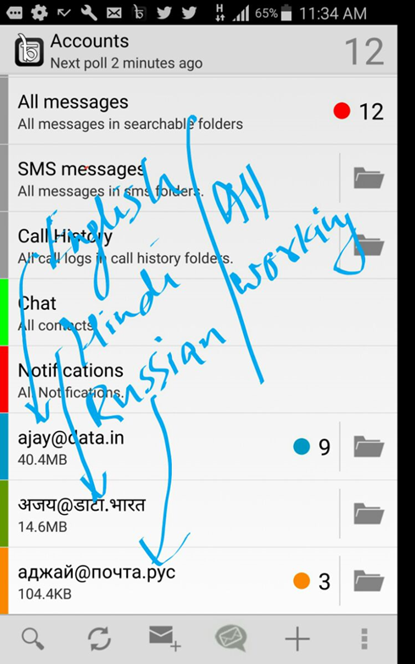

Slide 19
UA Capable e-mail software (NOW)
Roundcube
Outlook 2016
Gmail
phlyMail
postfix 3.0.4 (Docker)
Horde webmail
Centos 7.0
...

Slide 20
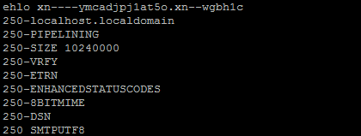
UA Capable e-mail software (from 2017)
MailMan
Yandex
...

Slide 21
Deployment Issues for Internationalized Email
IETF RFC
https://datatracker.ietf.org/doc/draft-elkchow-iea-deploy/

Slide 22
Other problems?
Hotel booking
Domain name registration
Every single contact form on the Internet.

Slide 23
Thanks !!!
Any questions?
Dušan Stojičević
GRANSY
stojicevic@gransy.com

