Slide 1
Internet impacts due to the war in Ukraine
Doug Madory, Kentik

Slide 2
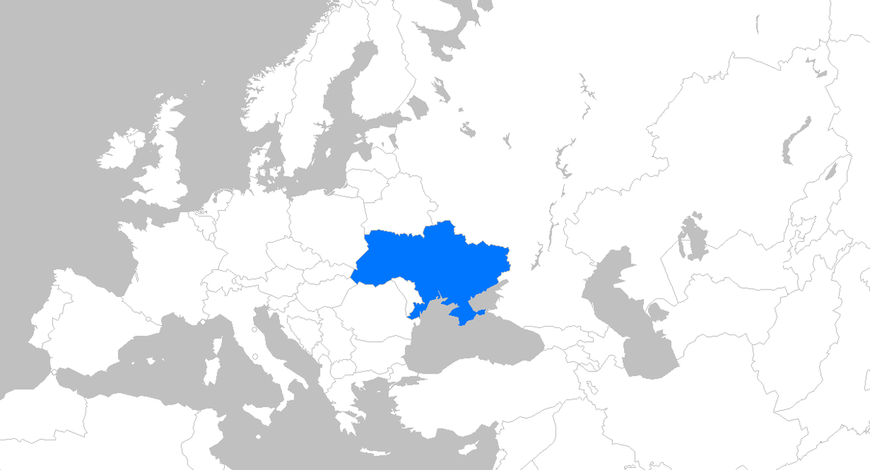
Internet impacts due to the war in Ukraine
Initial months of invasion (Feb-Mar 2022)
Impacts in Ukraine
Impacts in Russia
Conflict shifts east and south (Summer 2022)
Ukraine counteroffensive, Russian retaliation

Slide 3
Internet impacts due to the war in Ukraine
Initial months of invasion (Feb-Mar 2022)
Impacts in Ukraine
Impacts in Russia
Conflict shifts east and south (Summer 2022)
Ukraine counteroffensive, Russian retaliation

Slide 4
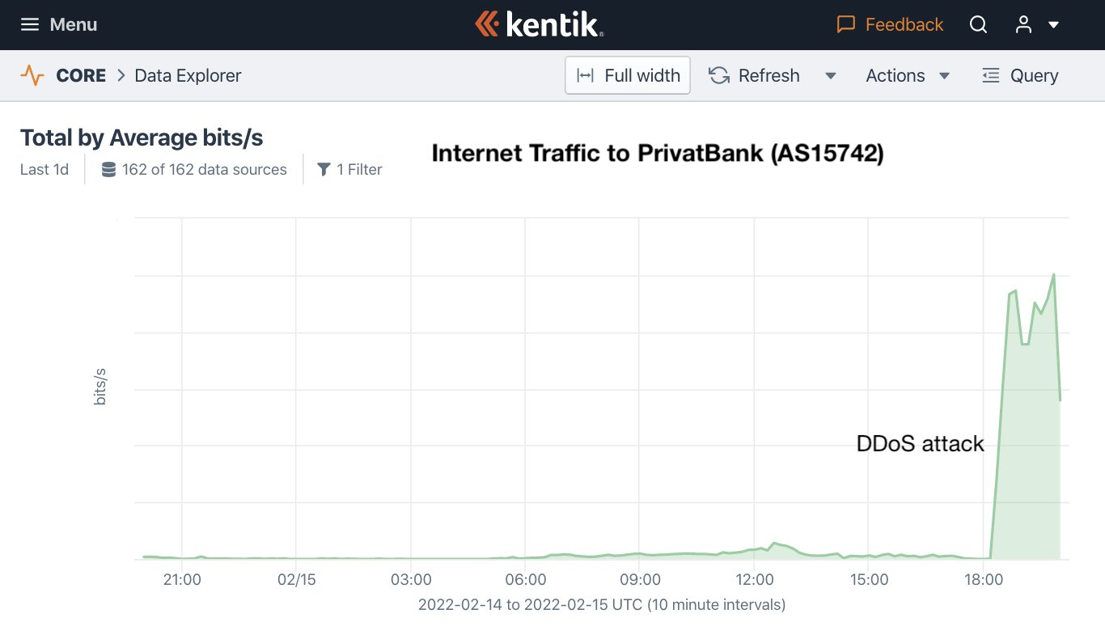
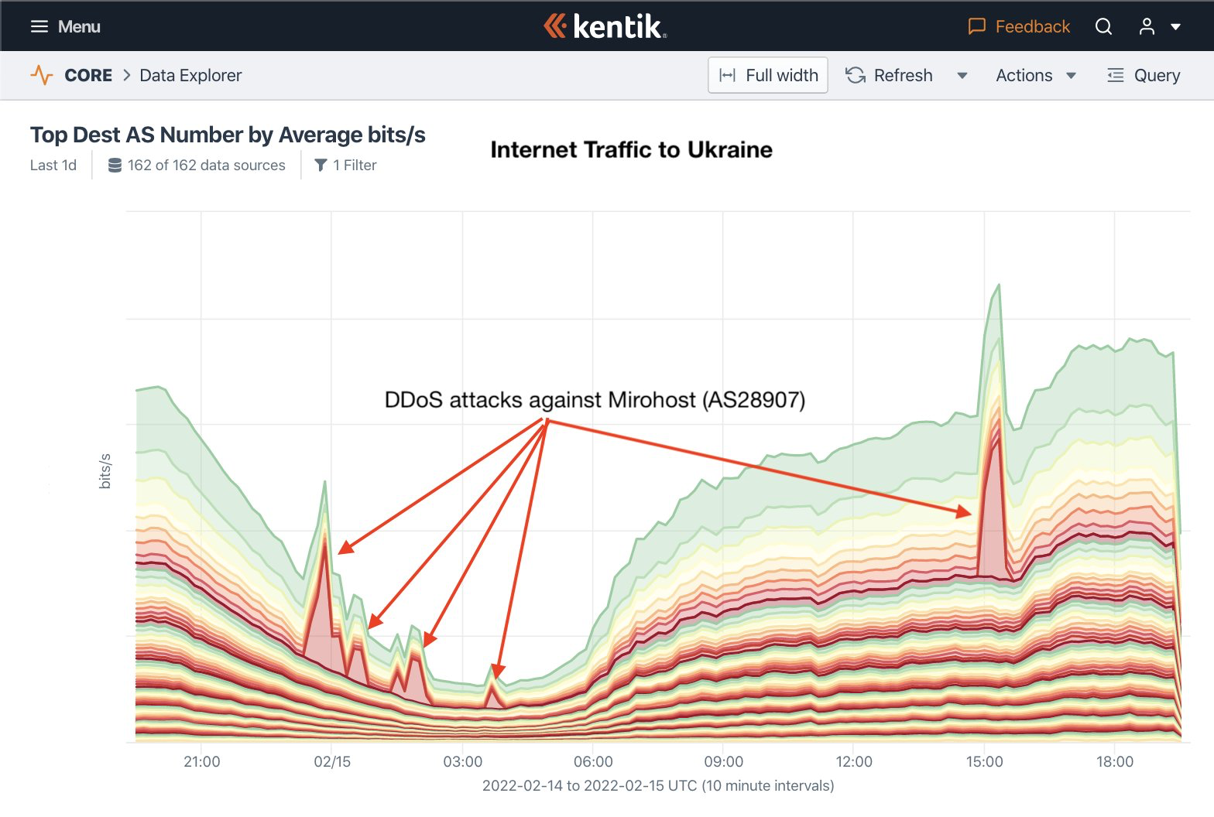
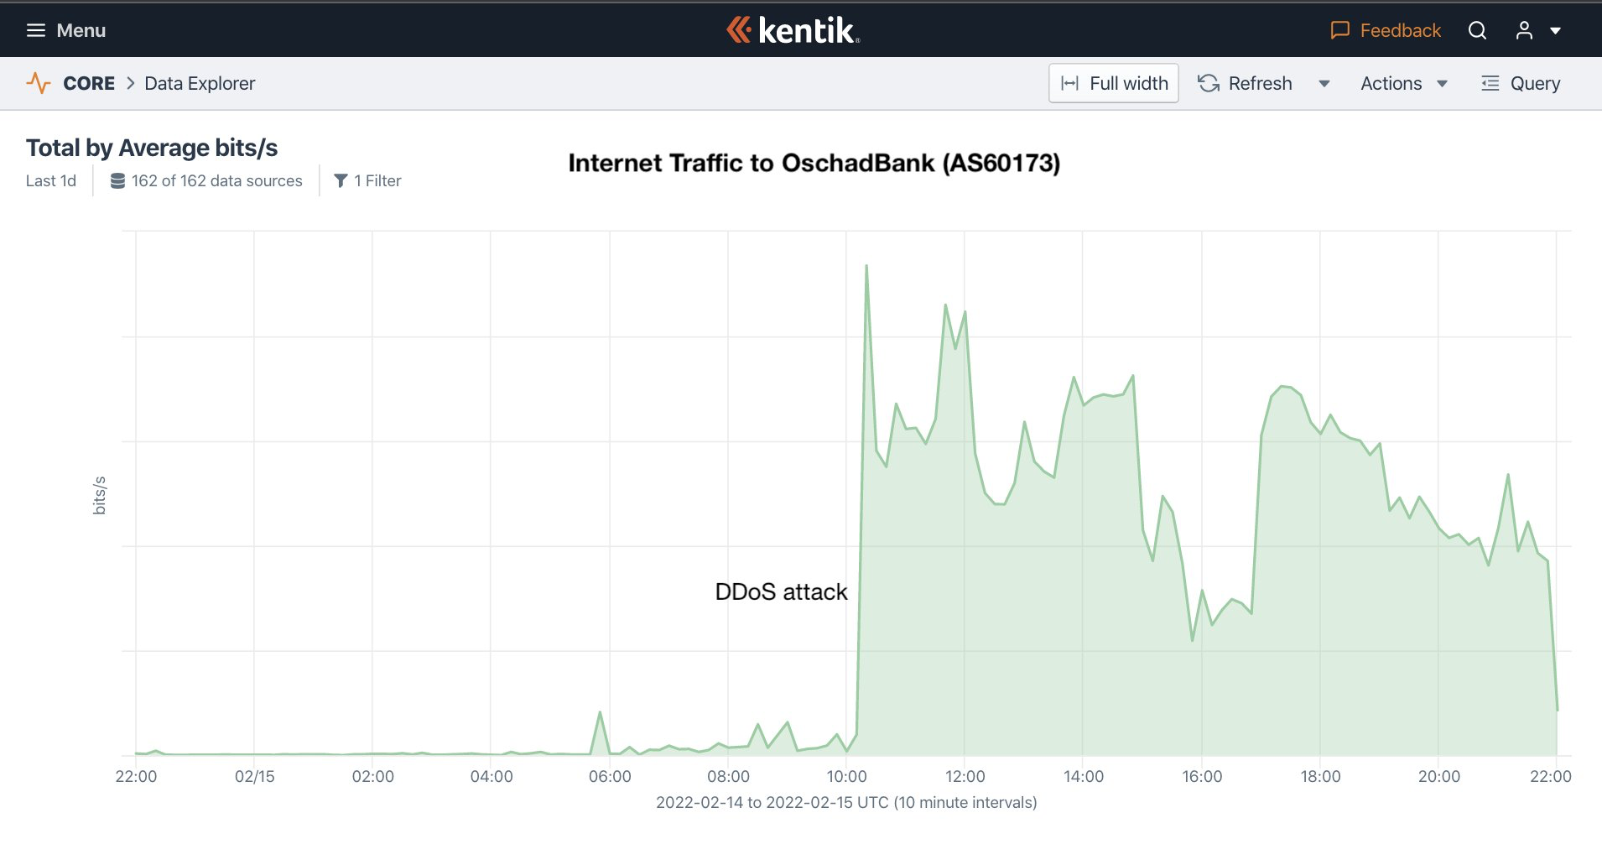
As NANOG 84 was winding down in Austin, TX in Feb…
Russian troops amassed on Ukraine’s border. Then the DDoS attacks began.
Initial targets included (15 Feb)
Mirohost (AS28907), hosts the Ukraine Army website.
Privatbank (AS15742), one of Ukraine's largest banks.
Oschadbank (AS60173), state savings bank of Ukraine.
https://twitter.com/DougMadory/status/1493680334965297159

Slide 5
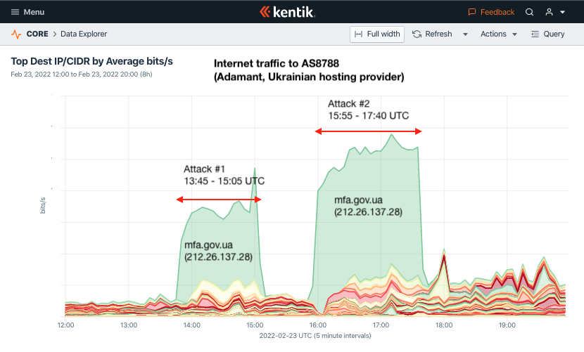
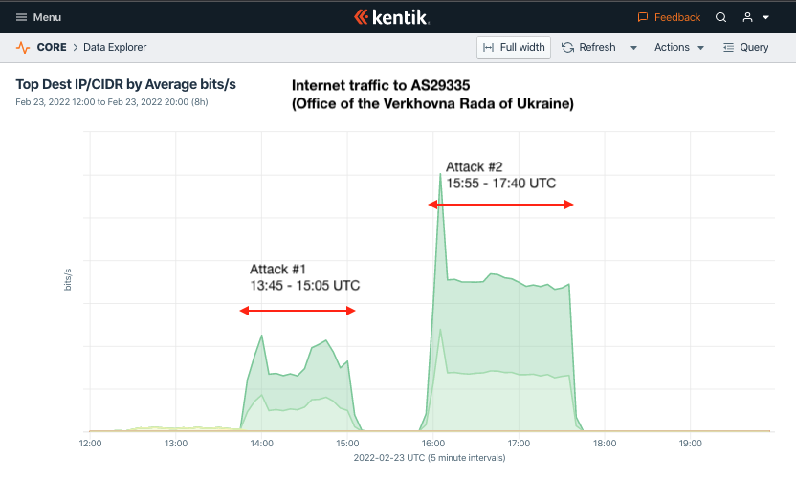
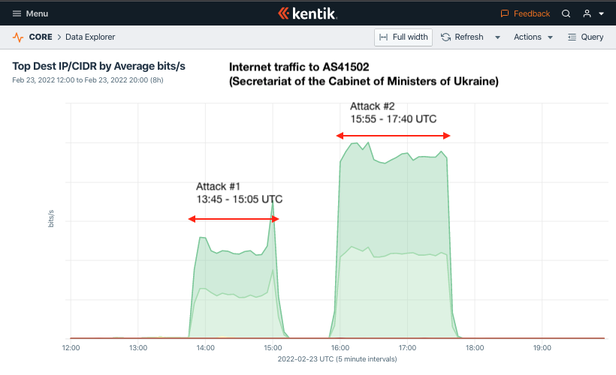
Ukraine became a frequent target of DDoS attacks
DDoS attacks continued and shifted to Ukrainian government targets.
On 23 February, the targets included Ukraine’s:
Parliament (Rada), foreign ministry (MFA), and executive cabinet (KMU)
Attacks weren’t novel or record-breaking in size, but did disrupt access.
https://twitter.com/DougMadory/status/1496598152706772993

Slide 6
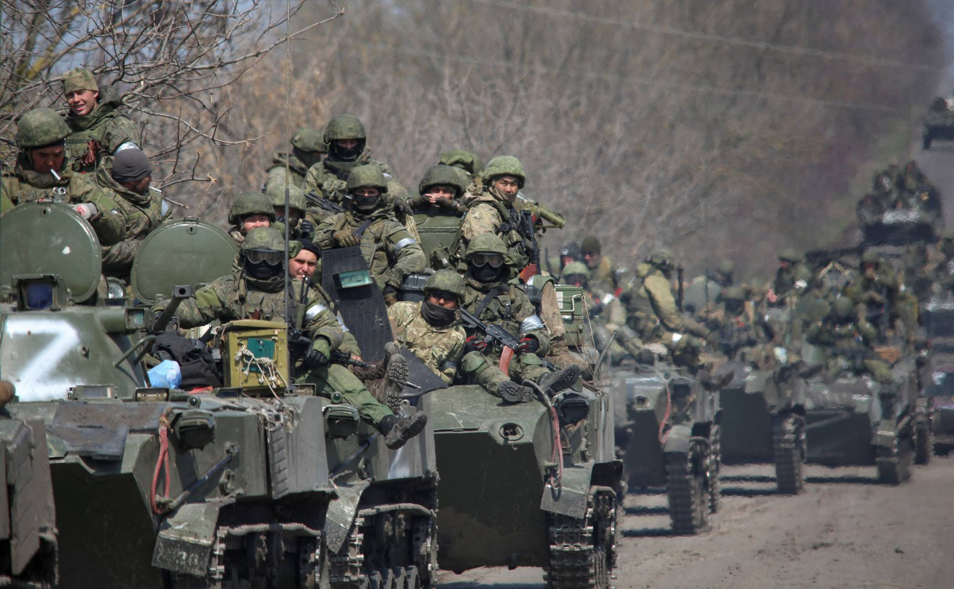
Russia invades Ukraine on early on 24 February

Slide 7
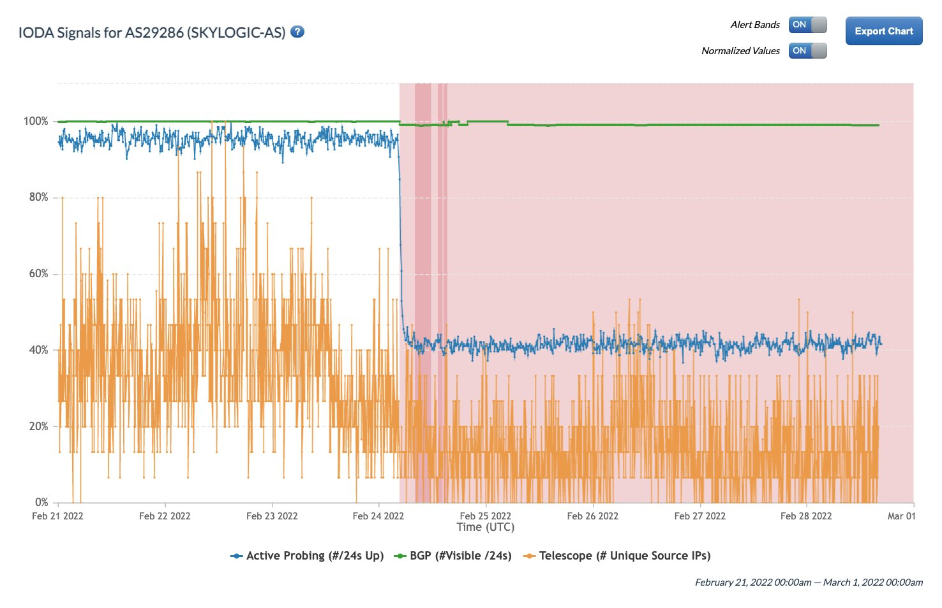
European satellite operator disrupted by cyberattack
24 Feb: Beginning at ~4:20 UTC, AS29286 experienced a large drop in traffic & responses to active probes.
28 Feb: SentinelOne reported satcom modems were commanded by compromised support servers to run destructive malware
“It was a really huge loss in communications in the very beginning of war,” Viktor Zhora, a senior official at Ukraine’s cybersecurity agency
https://www.sentinelone.com/labs/acidrain-a-modem-wiper-rains-down-on-europe/
https://twitter.com/gatech_ioda/status/1498349622808522756

Slide 8
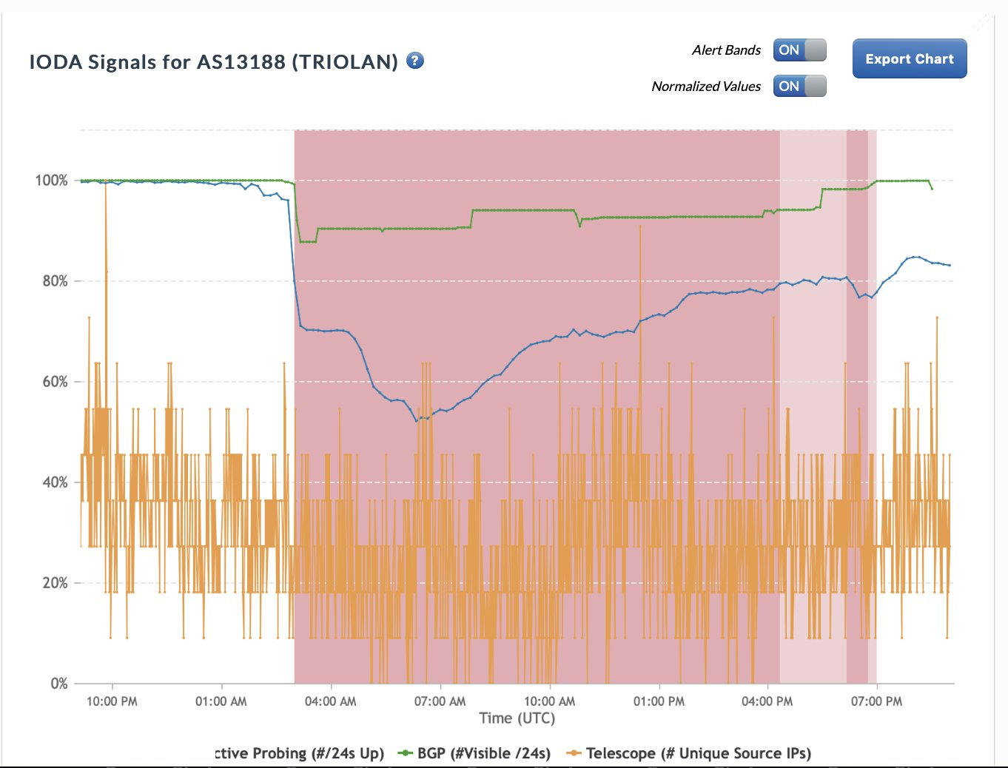
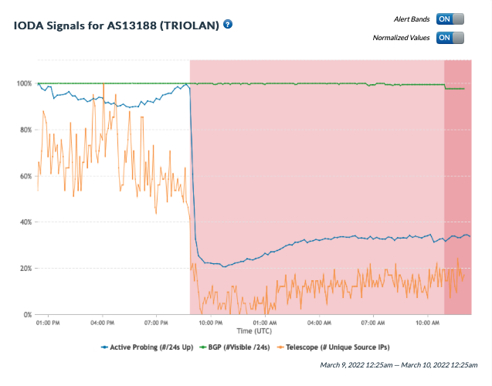
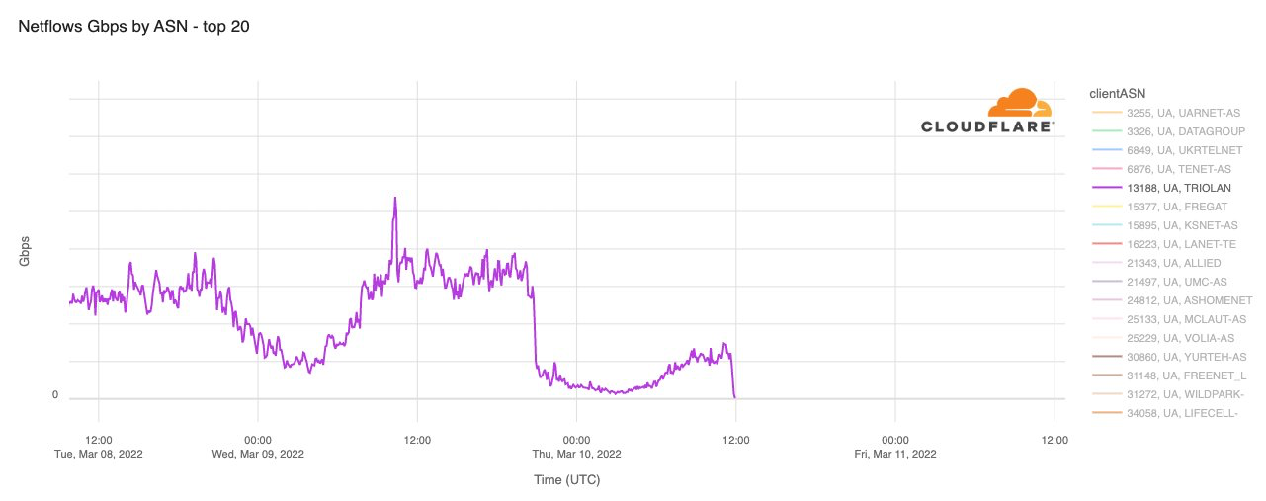
Outages in Ukraine following the invasion
25 Feb: largest initial outage was national broadband operator Triolan (AS13188).
Triolan would later go down twice more as a result of “cyberattacks” against their network.
25 Feb outage due to severed fiber cable.
9 March outage due to cyberattack.
9 March outage due to cyberattack.

Slide 9
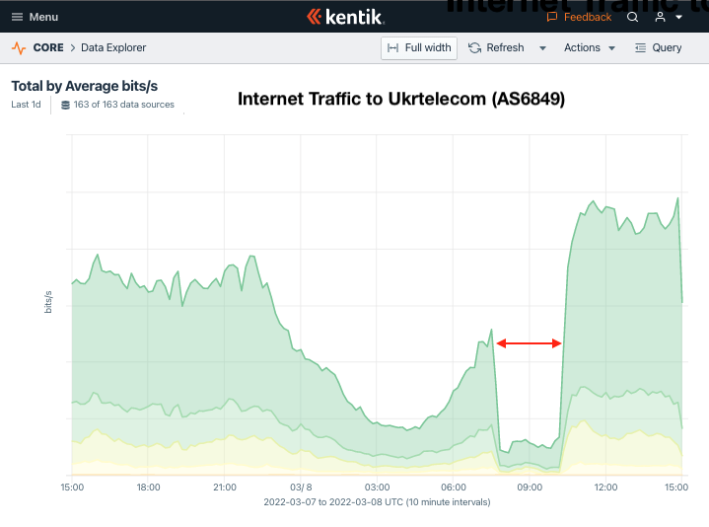
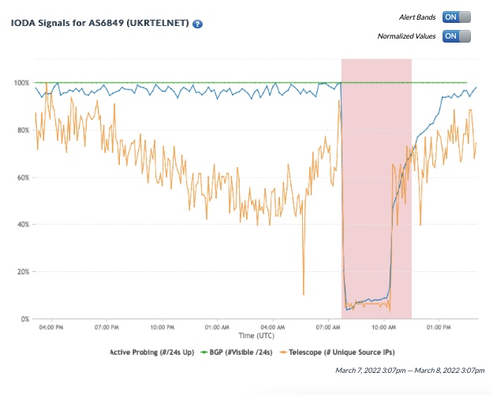
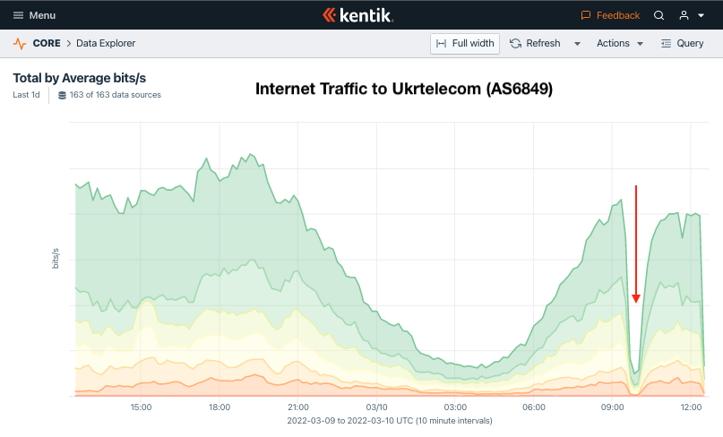
Outages in Ukraine following the invasion
Ukrainian incumbent Ukrtelecom (AS6849) also experienced multiple outages.
Only the 7th most popular traffic destination in Ukraine, but incumbents are often only option for service to rural areas.

Slide 10
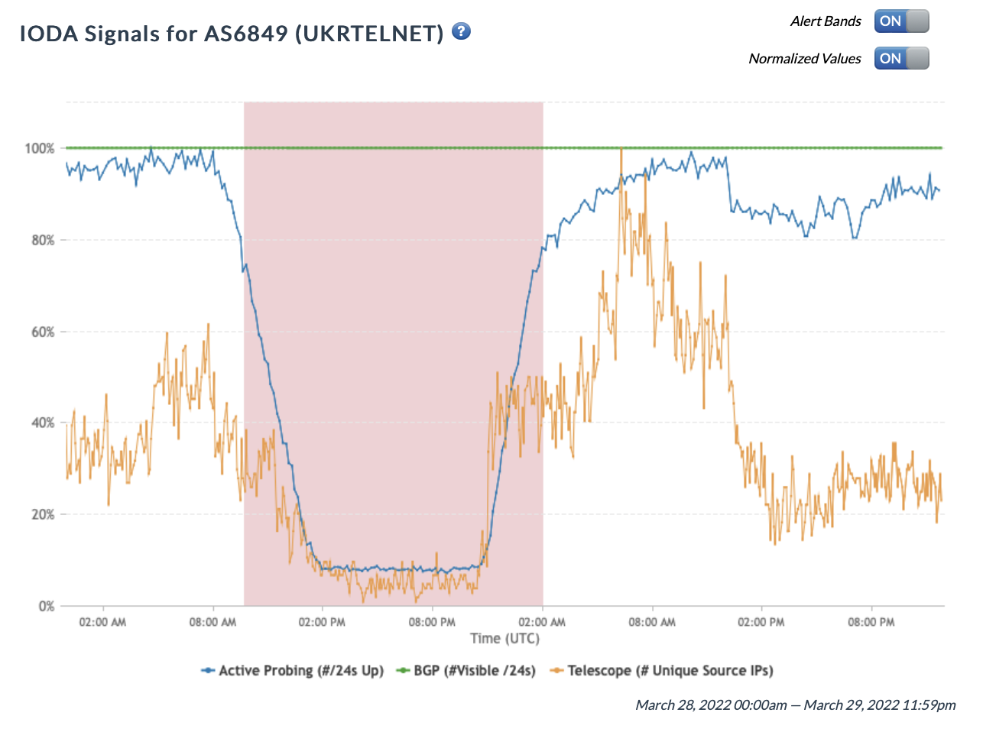
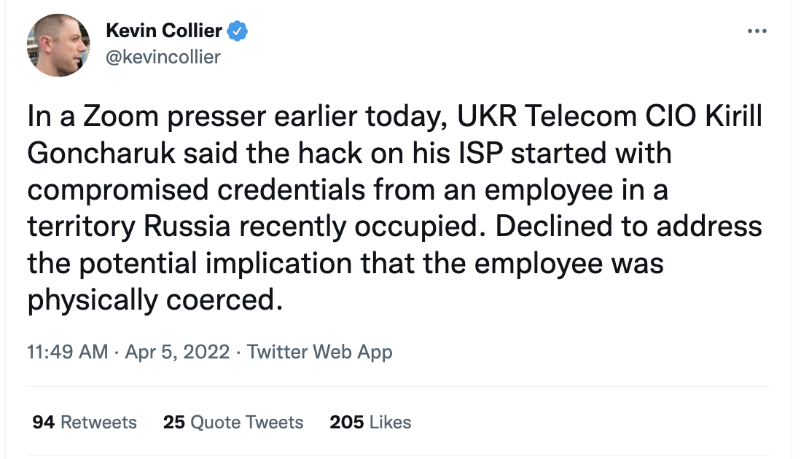
Outages in Ukraine following the invasion
Ukrtelecom also suffered an outage on 28 March due to a “cyberattack” - note the slow decline in connectivity over ~5hrs.→
Few details about the attack emerged…

Slide 11
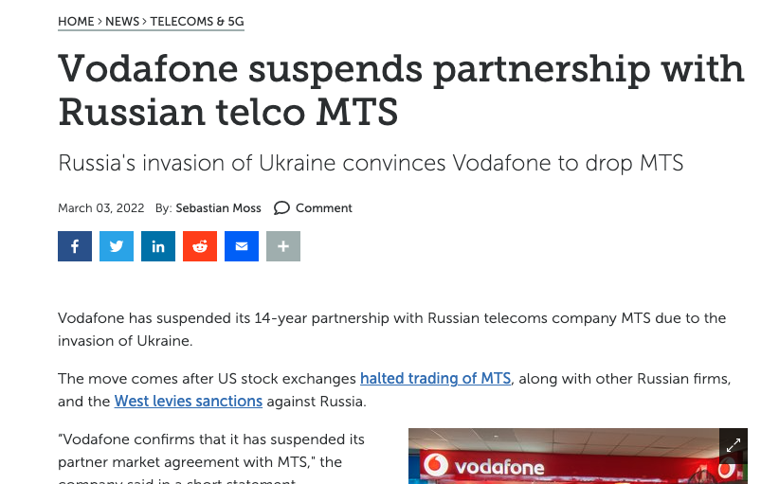
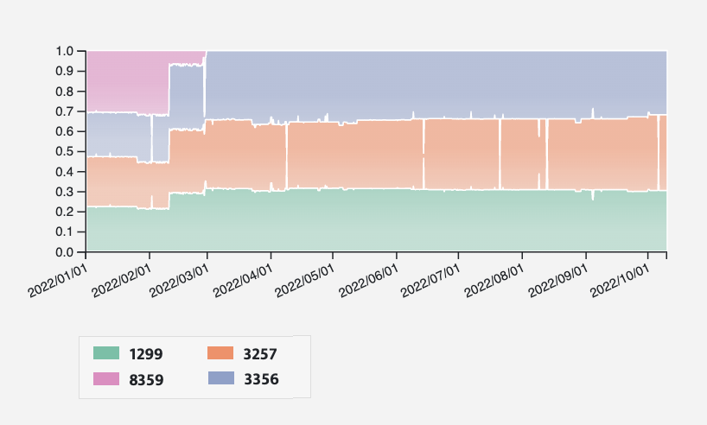
Not only outages, transit in Ukraine was also affected
Internet transit for AS21497 (Vodafone Ukraine)
Vodafone Ukraine (AS21497) lost transit from MTS (AS8359) on February 28, 2022.
https://www.datacenterdynamics.com/en/news/vodafone-suspends-partnership-with-russian-telco-mts/

Slide 12
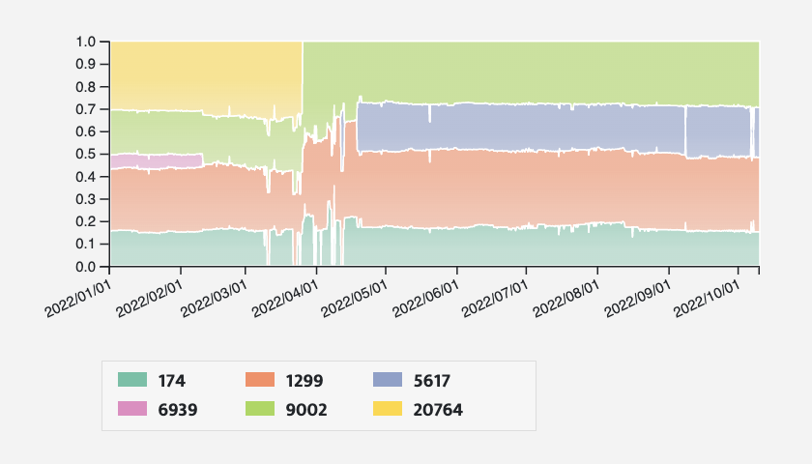
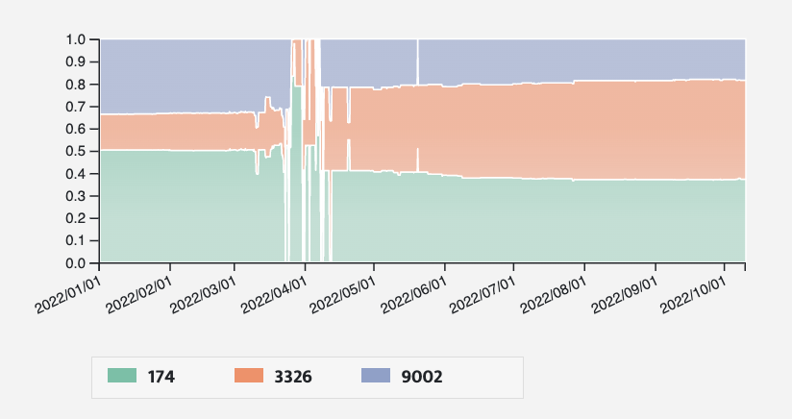
Not only outages, transit in Ukraine was also affected
Internet transit for AS3326 (Datagroup)
Internet transit for AS25229 (Volia)
Loss of transit from AS20764 (Rascom, Russia)
Transit instability during initial phase of conflict.

Slide 13
Internet impacts due to the war in Ukraine
Initial months of invasion (Feb-Mar 2022)
Impacts in Ukraine
Impacts in Russia
Conflict shifts east and south (Summer 2022)
Ukraine counteroffensive, Russian retaliation

Slide 14
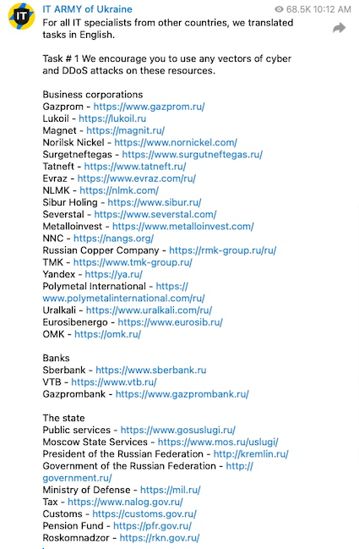
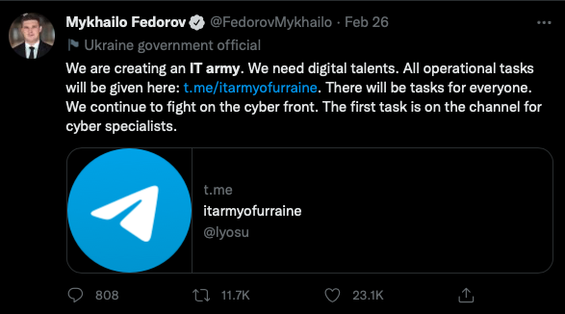
Ukraine calls for help on the Internet
26 Feb: Ukraine’s Minister for Digital Transformation called for the formation of a volunteer ‘‘IT army’’ of hackers to target 31 important Russian websites.
He called it ‘World Cyberwar I’.
https://twitter.com/FedorovMykhailo/status/1497642156076511233

Slide 15
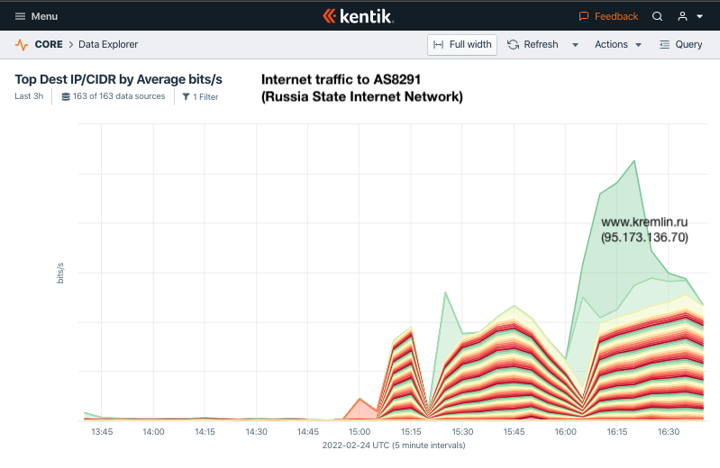
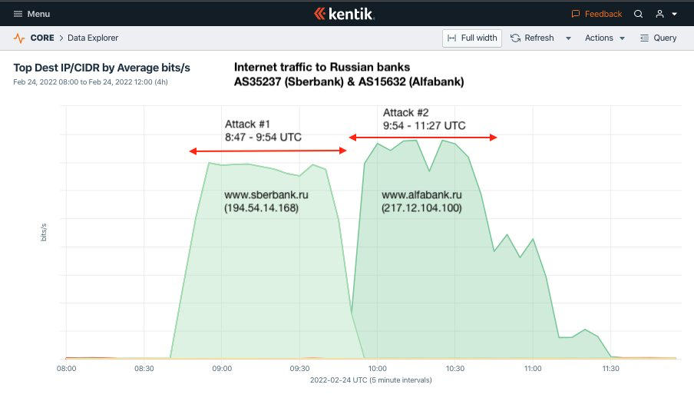
Russian Internet become a target of DDoS attacks
Even before Federov’s call to action, RU DDoS targets included http://kremlin.ru hosted by AS8291 (Russia State Internet Network).
Sberbank (AS35257) and Alfabank (AS15632) were targeted in consecutive DDoS attacks on 24 Feb.
https://twitter.com/DougMadory/status/1496961857638309893

Slide 16
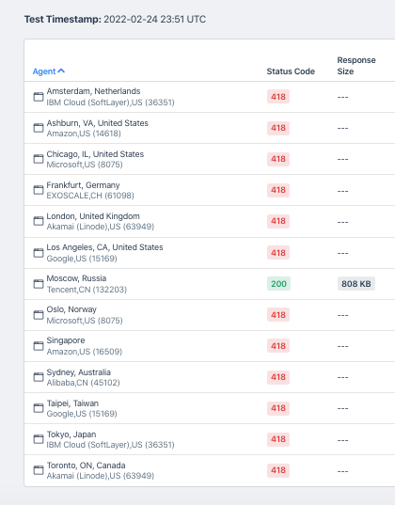
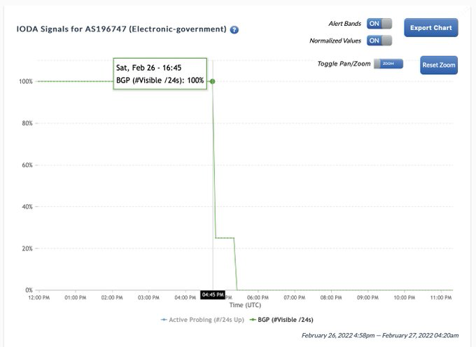
Russian Internet become a target of DDoS attacks
Rostelecom stopped announcing the BGP routes of Russia's e-government platform (AS196747) outside the country on 26-Feb. It hosts one of the 31 sites on Ukraine’s hitlist.
Mil.ru was restricted to Russian IPs only.
Outsiders received the 418 “I'm a teapot” error used to let users know they are being blocked.

Slide 17
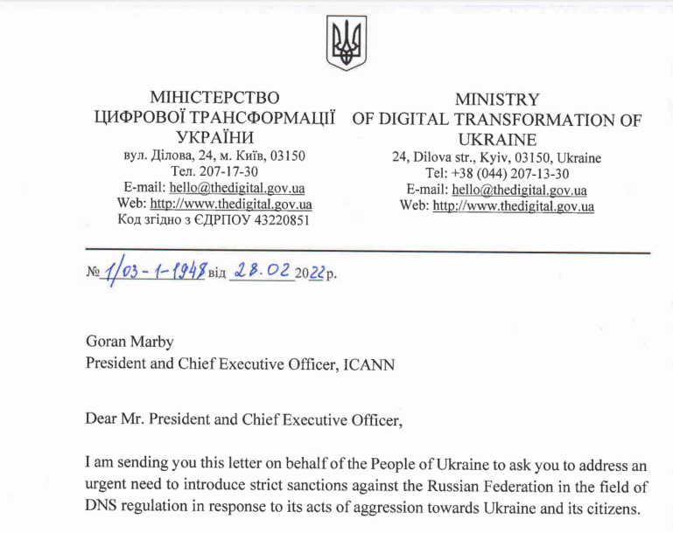
Ukraine request that Russia be disconnected
28 Feb: Ukraine’s Minister for Digital Transformation requests Internet orgs work to disconnect the Russia.
For ICANN
Shut down DNS root servers in Russia
Revoke Russian TLDs (.ru, .рф, .su)
For RIPE
Withdraw the right to use all IPv4 and IPv6 addresses by all Russian members.
Block DNS root servers that it is operating.
ICANN and RIPE refuse.

Slide 18
Ukraine request led to a controversial idea…
Use Internet governance model to facilitate discussion of resources should be blocked to affect sanctions against violators of international and human rights law.
Produce real-time BGP and RPZ data feeds of network resources (IP addresses, ASNs, and domain names) associated with sanctioned entities.
Block without impinging upon civilians' access to information and communications.
Neither pro-sanction nor anti-sanction but it exists to facilitate public/private-sector coordination while ensuring that the human rights of civilians are protected.
https://wiki.sanctions.net/index.php/Welcome_to_the_Internet_Sanctions_Project

Slide 19
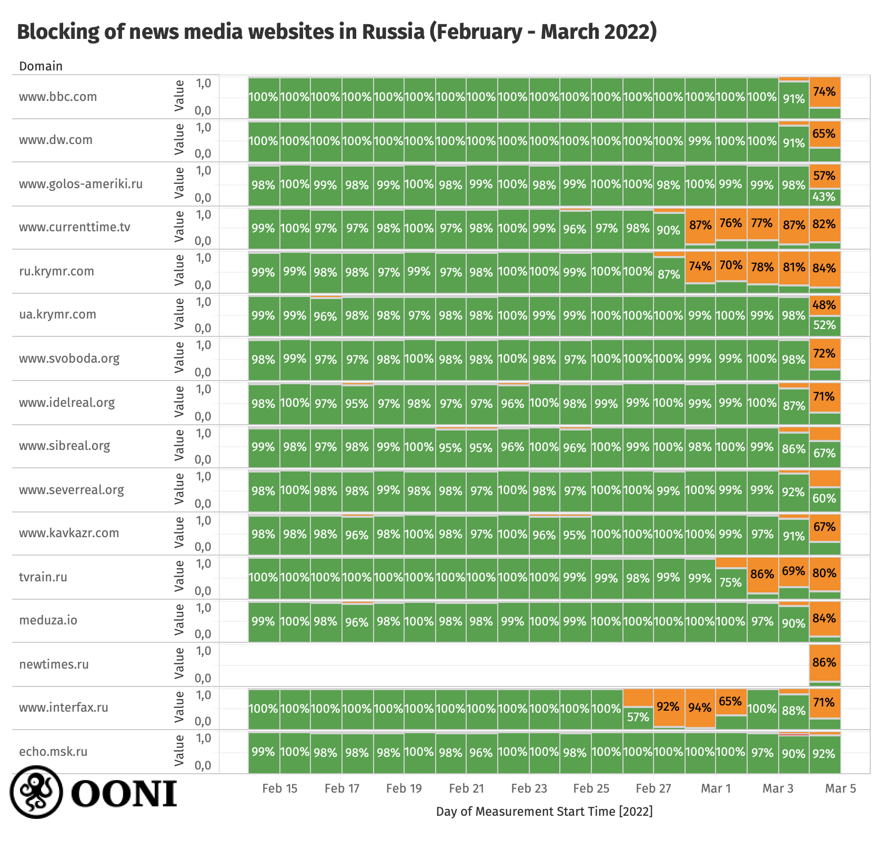
Russia begins blocking international news, social media
Blocking of independent Russian news & foreign news sites
Centralized throttling of Twitter
Decentralized censorship using multiple techniques.
See OONI’s excellent report:
https://ooni.org/post/2022-russia-blocks-amid-ru-ua-conflict/

Slide 20
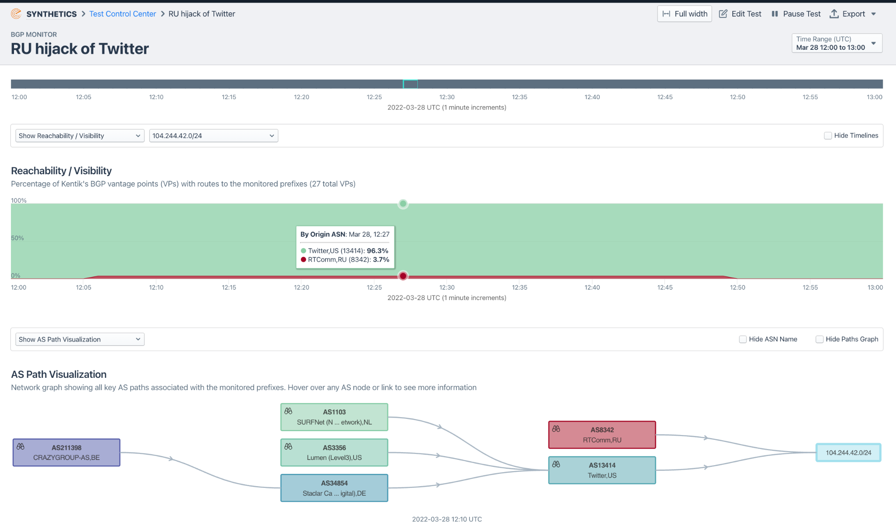
Russia begins blocking international news, social media
Inadvertent global BGP hijack of Twitter on 28 March.
From 12:05-12:50 UTC, Russian telecom RTComm (AS8342) hijacked 104.244.42.0/24 belonging to Twitter.
Same prefix was hijacked during the military coup in Myanmar last year, however…
It fared much better this time due to an RPKI ROA which enabled other networks to simply drop the erroneous Russian announcement.
https://twitter.com/DougMadory/status/1508466367112093709

Slide 21
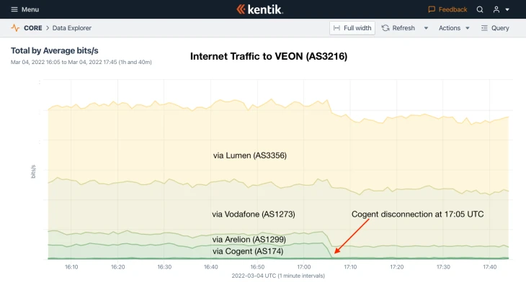
Cogent and Lumen curtail operations in Russia
3 March 2022: Cogent notified customers in Russia that service was being discontinued:
Transtelecom (TTK) and VEON were among a handful of RU networks that were disconnected from Cogent.
VEON was re-connected the following week.
Other RU customers (including Rostelecom) were never disconnected.
Lumen issued similar statement, no practical effect.
RU continues to be well connected to global Internet.
https://www.kentik.com/blog/cogent-disconnects-from-russia/

Slide 22
Internet impacts due to the war in Ukraine
Initial months of invasion (Feb-Mar 2022)
Impacts in Ukraine
Impacts in Russia
Conflict shifts east and south (Summer 2022)
Ukraine counteroffensive, Russian retaliation

Slide 23
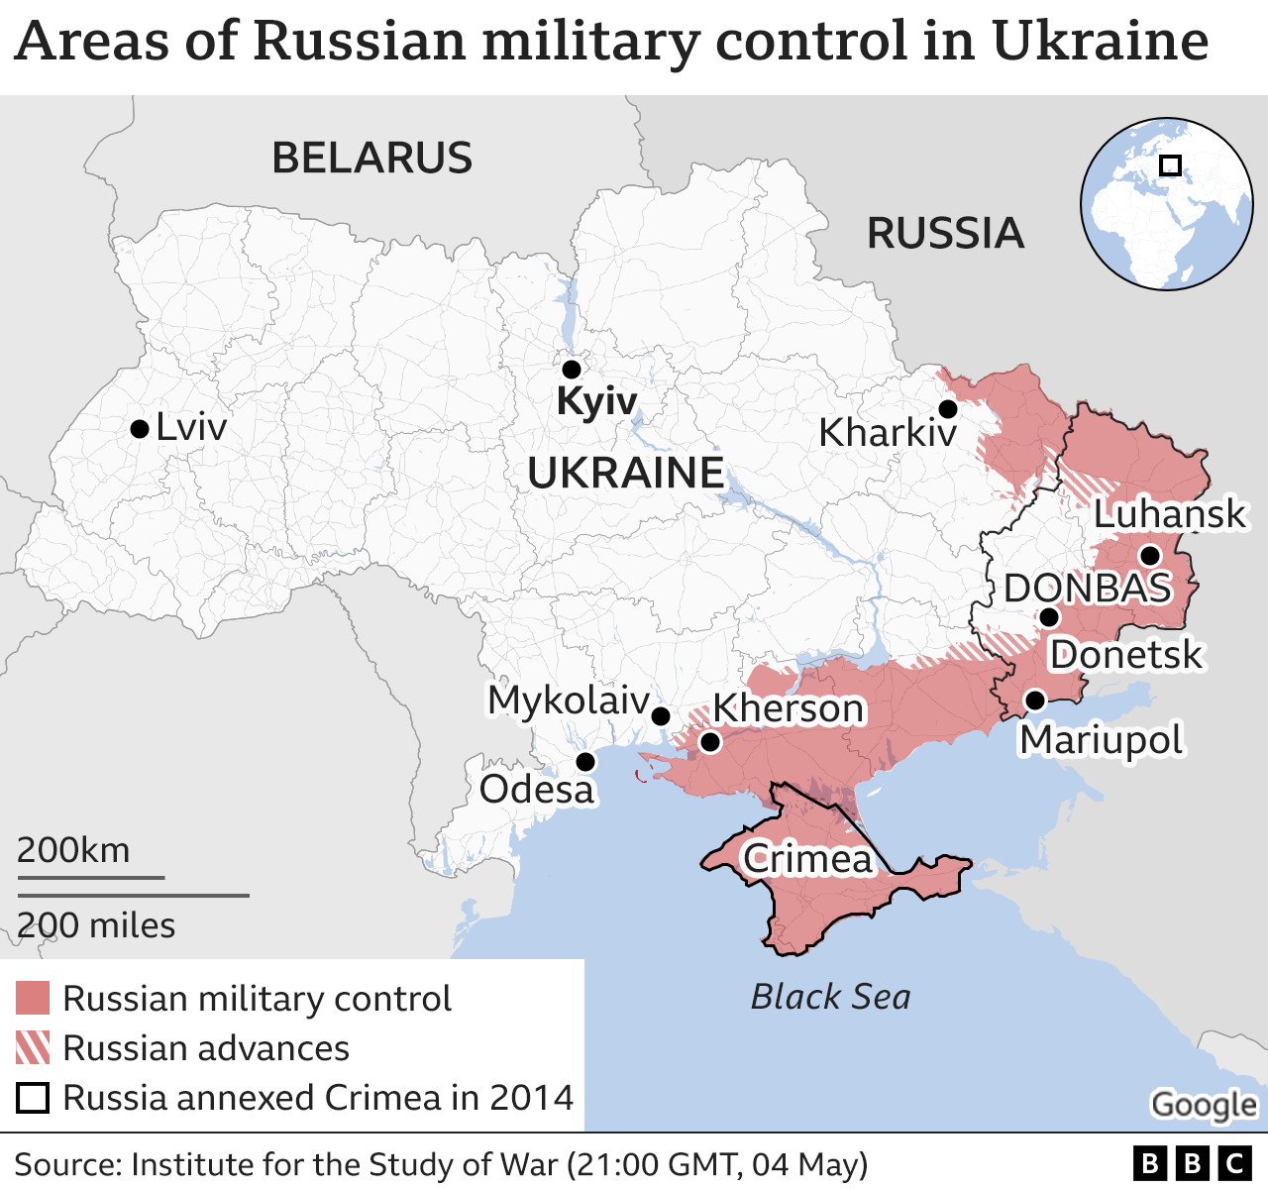
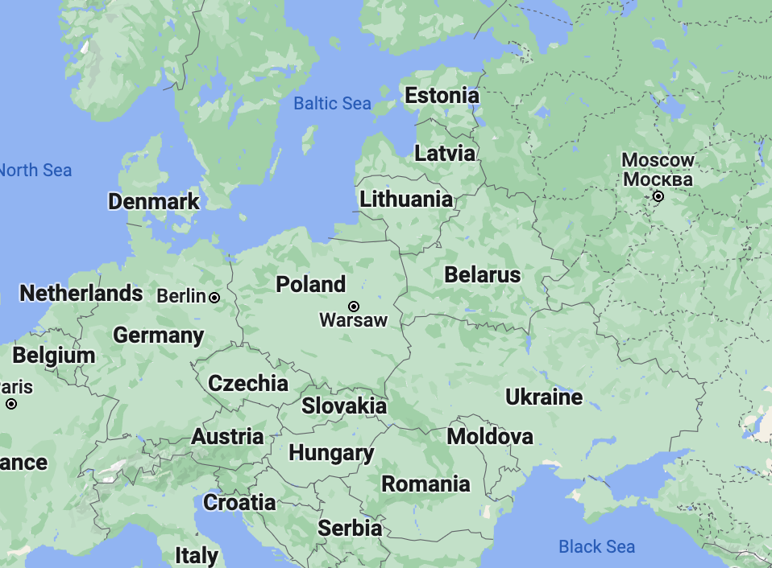
Eastern Ukraine: Donbas region (Donetsk and Luhansk)
Russian-held areas in eastern Donbas
Have used RU transit almost exclusively since 2014
BGP/DNS hijacks of 2018 misdirected to Luhansk
Internet partition along UA/RU lines
RTT latencies between areas can be >100ms
Approaching RTT across Pacific Ocean

Slide 24
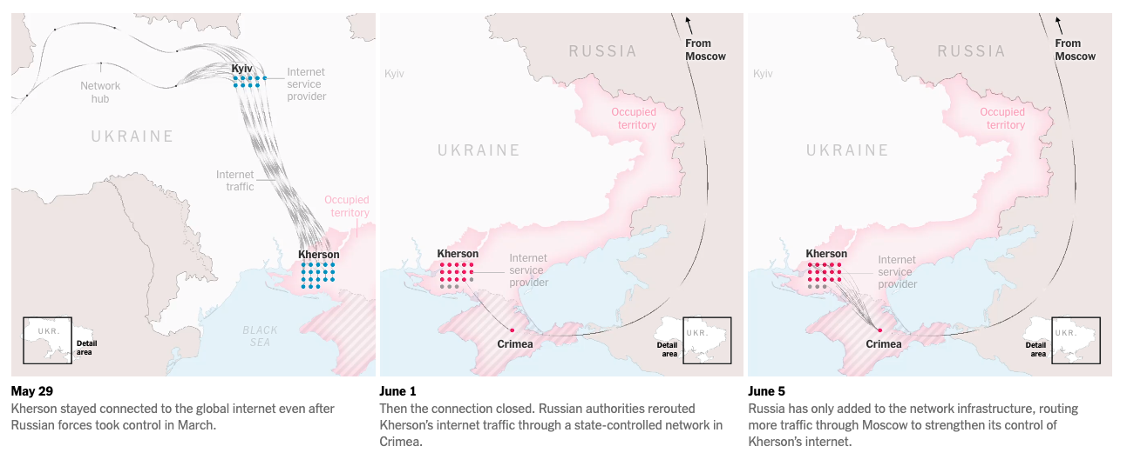
Southern Ukraine: switchover to Russian transit
March 2014: Russia annexed Crimean Peninsula from Ukraine
Crimea Internet re-routed via Miranda Media (AS201776) in July 2014.
Kherson Internet re-routed via AS201776 in June 2022.
How Russia Took Over Ukraine’s Internet in Occupied Territories
(New York Times, Aug 9)
All Kherson ISPs switch to Russian transit beginning June 1, 2022.
https://www.nytimes.com/interactive/2022/08/09/technology/ukraine-internet-russia-censorship.html
https://www.kentik.com/blog/rerouting-of-kherson-follows-familiar-gameplan/

Slide 25
Internet impacts due to the war in Ukraine
Initial months of invasion (Feb-Mar 2022)
Impacts in Ukraine
Impacts in Russia
Conflict shifts east and south (Summer 2022)
Ukraine counteroffensive, Russian retaliation

Slide 26
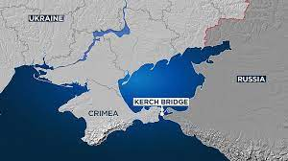
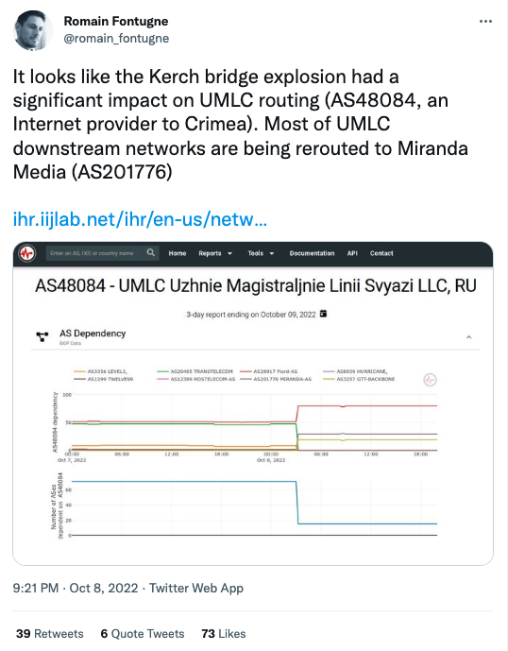
Latest: Kerch bridge damaged in attack (Oct-8)
https://twitter.com/romain_fontugne/status/1578918563121090560

Slide 27
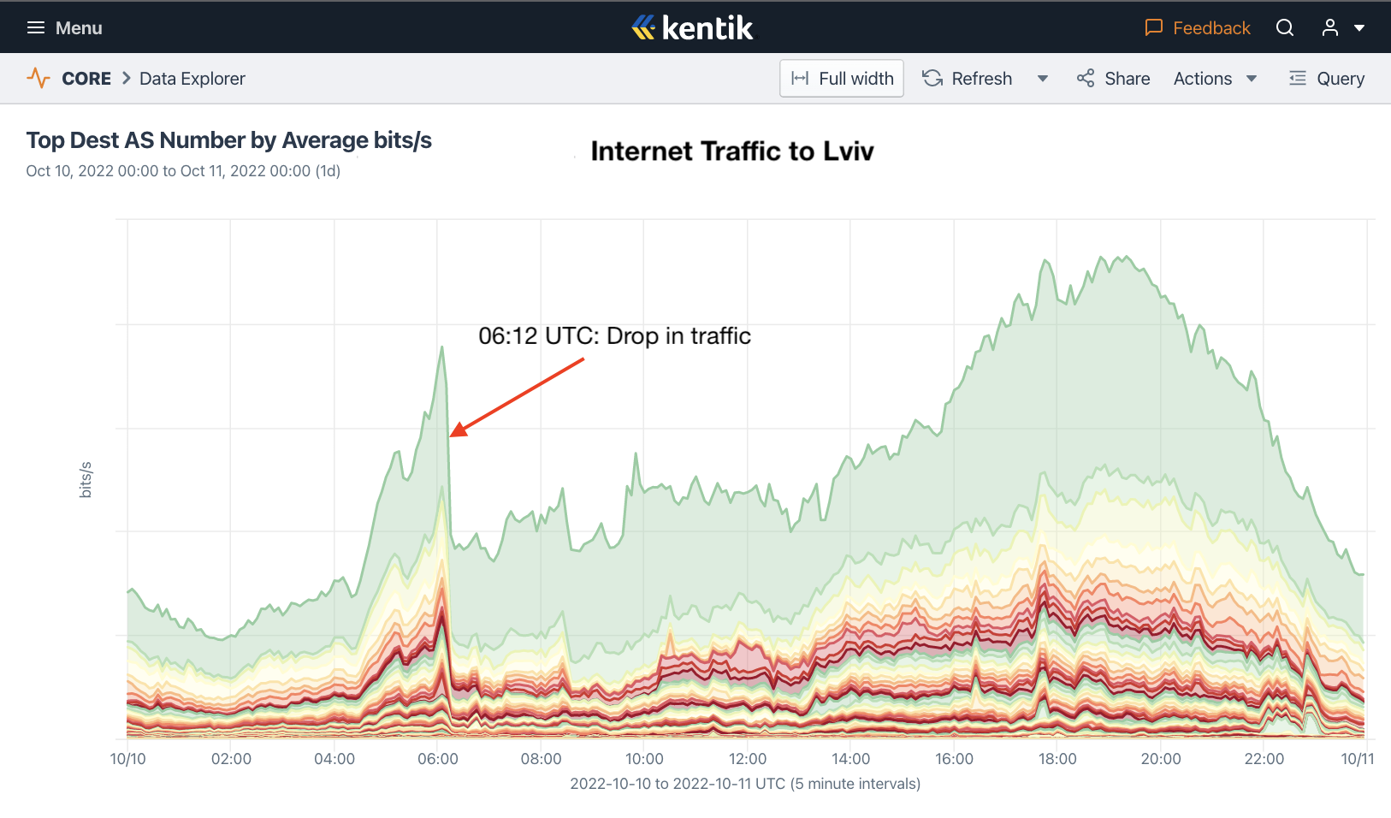
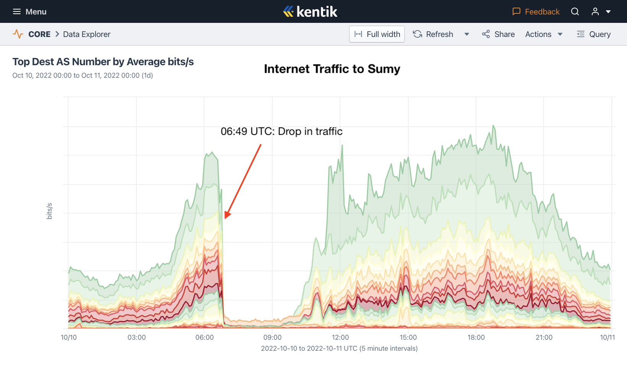
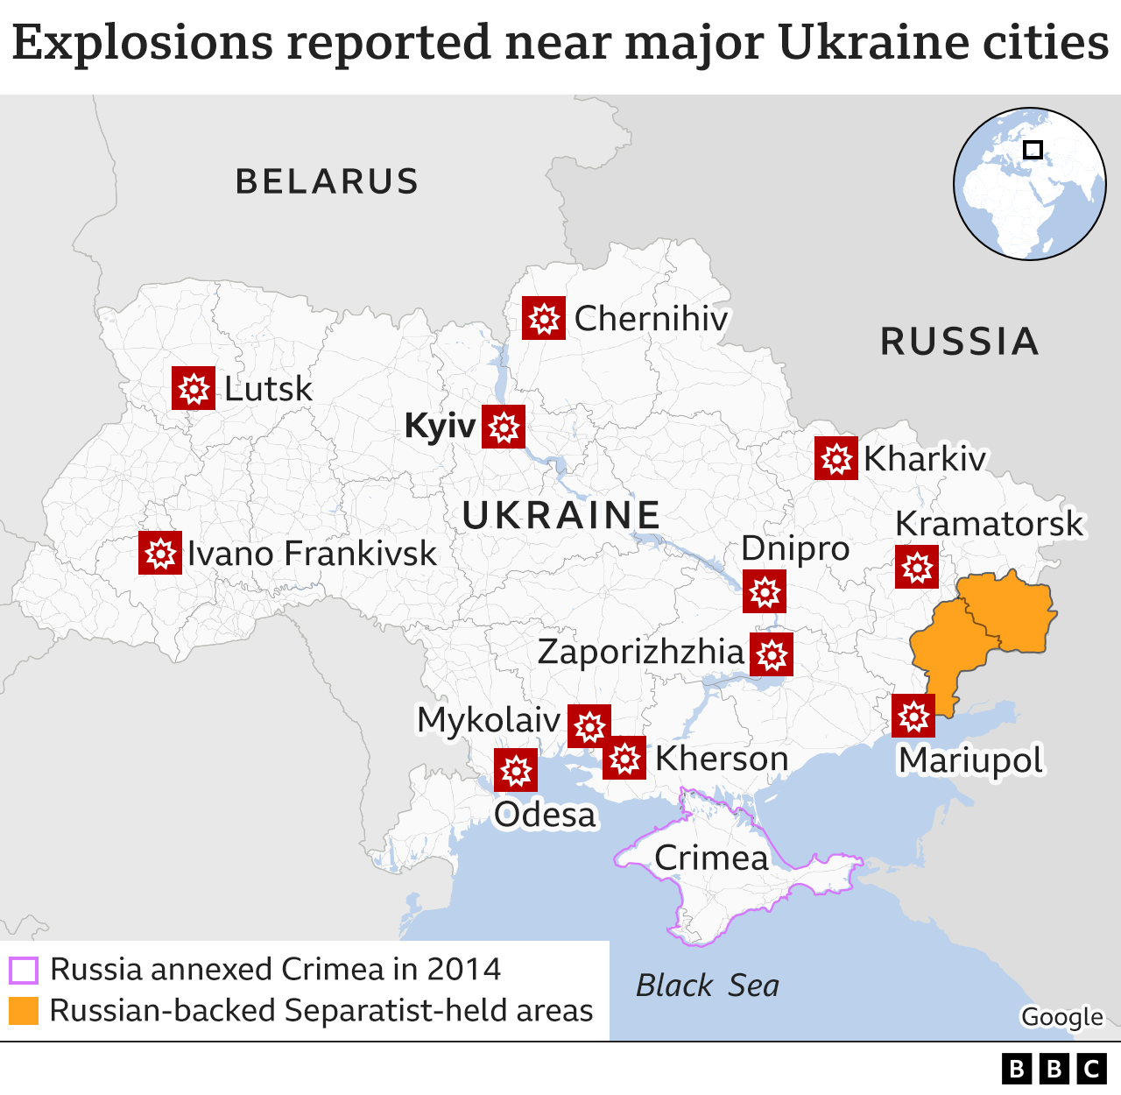
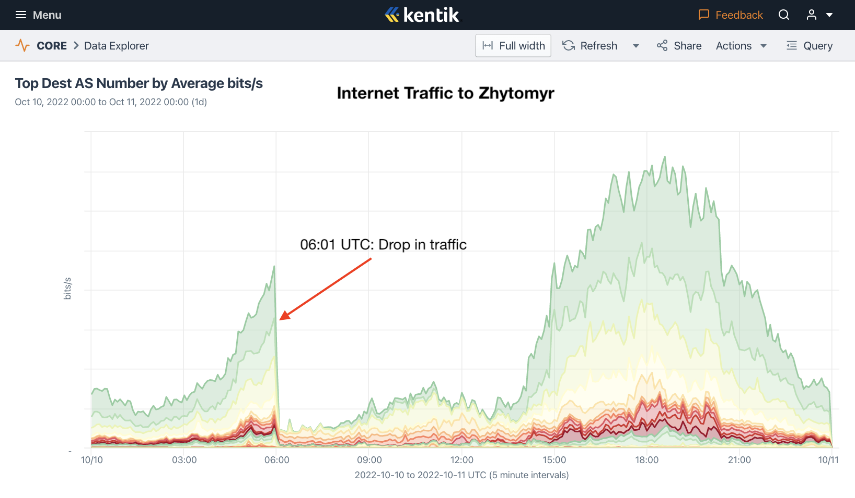
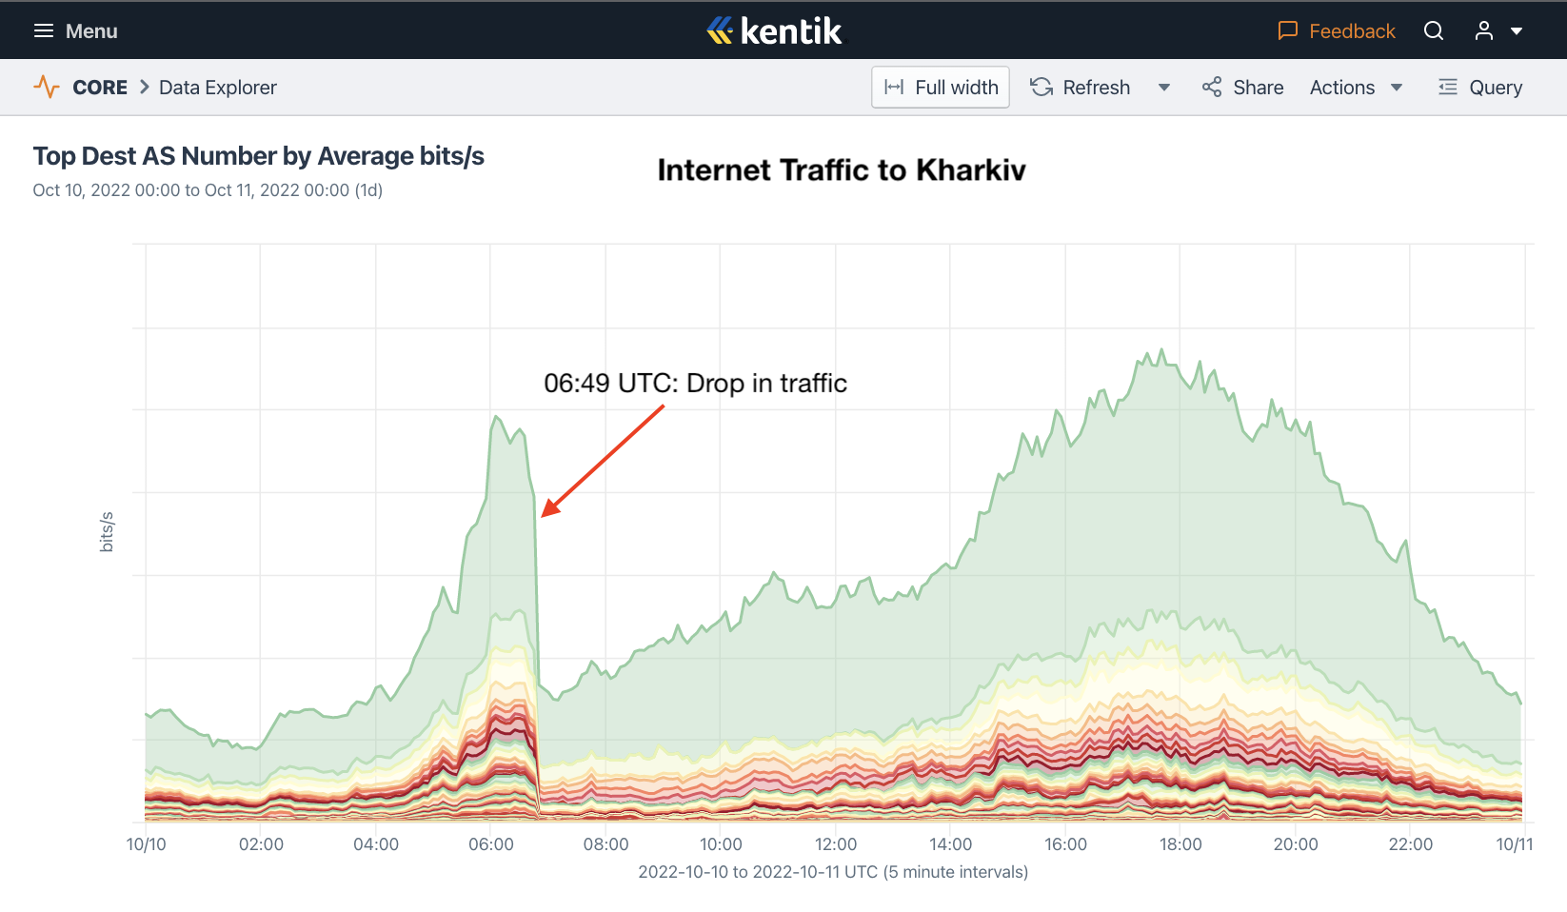
Russia retaliates with attacks on numerous Ukrainian cities
Internet outages due to power outages as electrical infrastructure was among targets.

Slide 28
Internet impacts due to the war in Ukraine
Initial months of invasion (Feb-Mar 2022)
Impacts in Ukraine
Impacts in Russia
Conflict shifts east and south (Summer 2022)
Ukraine counteroffensive, Russian retaliation
Conclusion

Slide 29
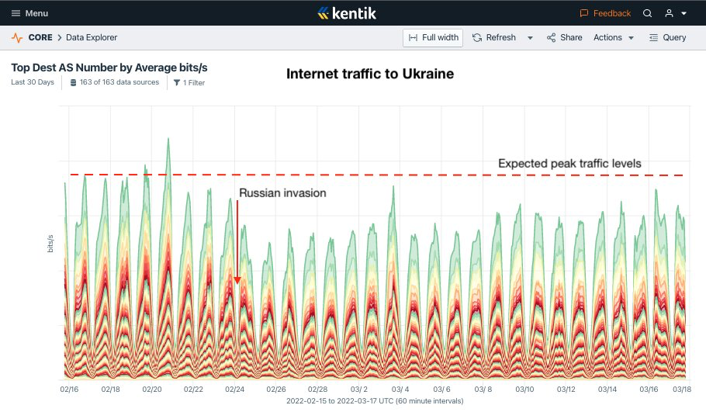
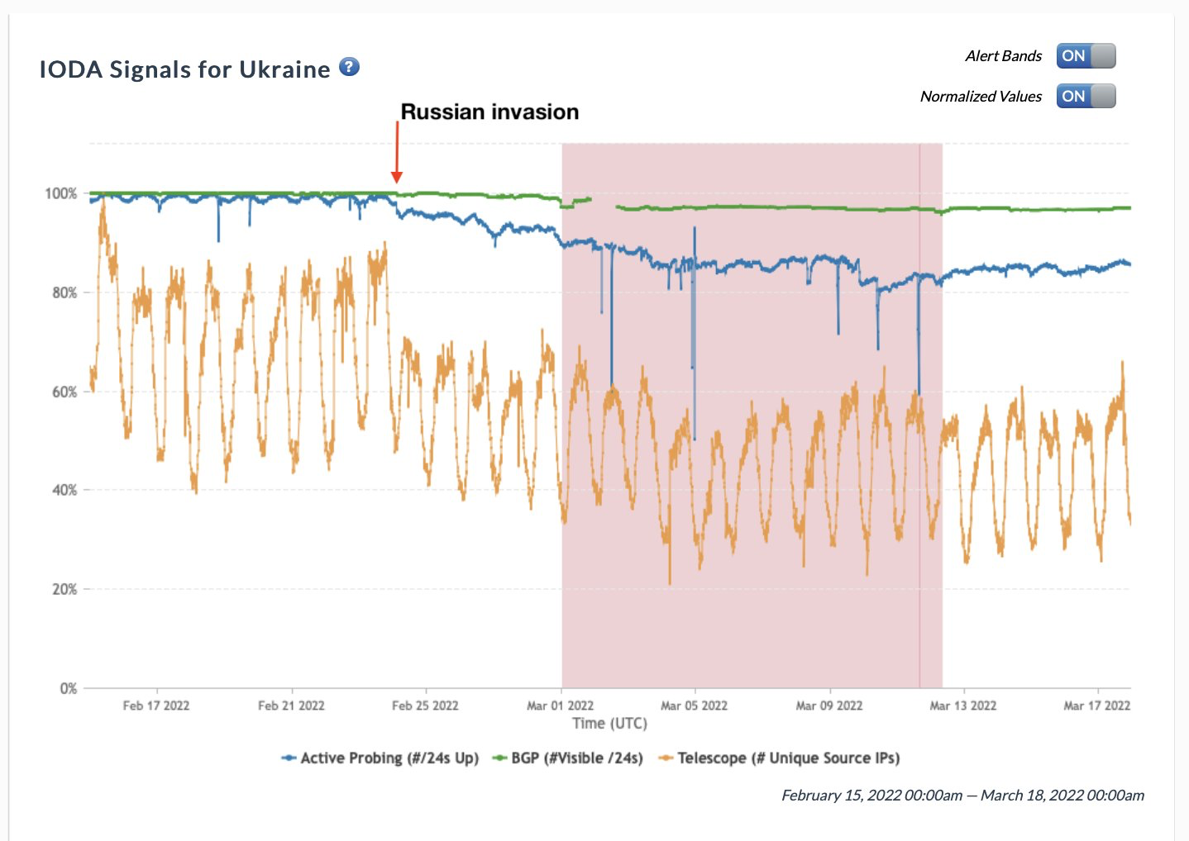
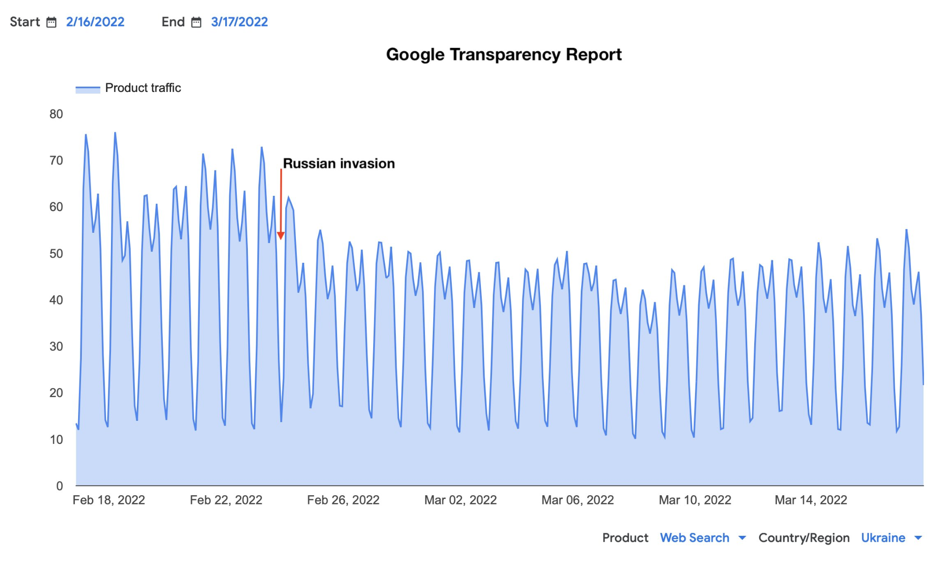
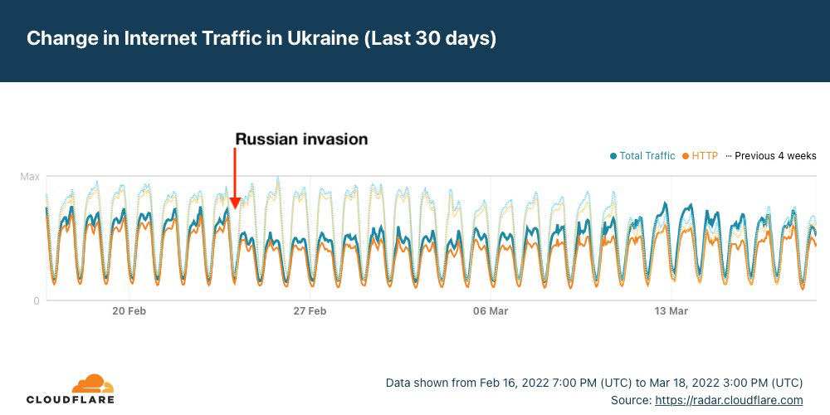
Ukraine stayed online
https://twitter.com/DougMadory/status/1504904422077444101
https://labs.ripe.net/author/emileaben/the-resilience-of-the-internet-in-ukraine/

Slide 30
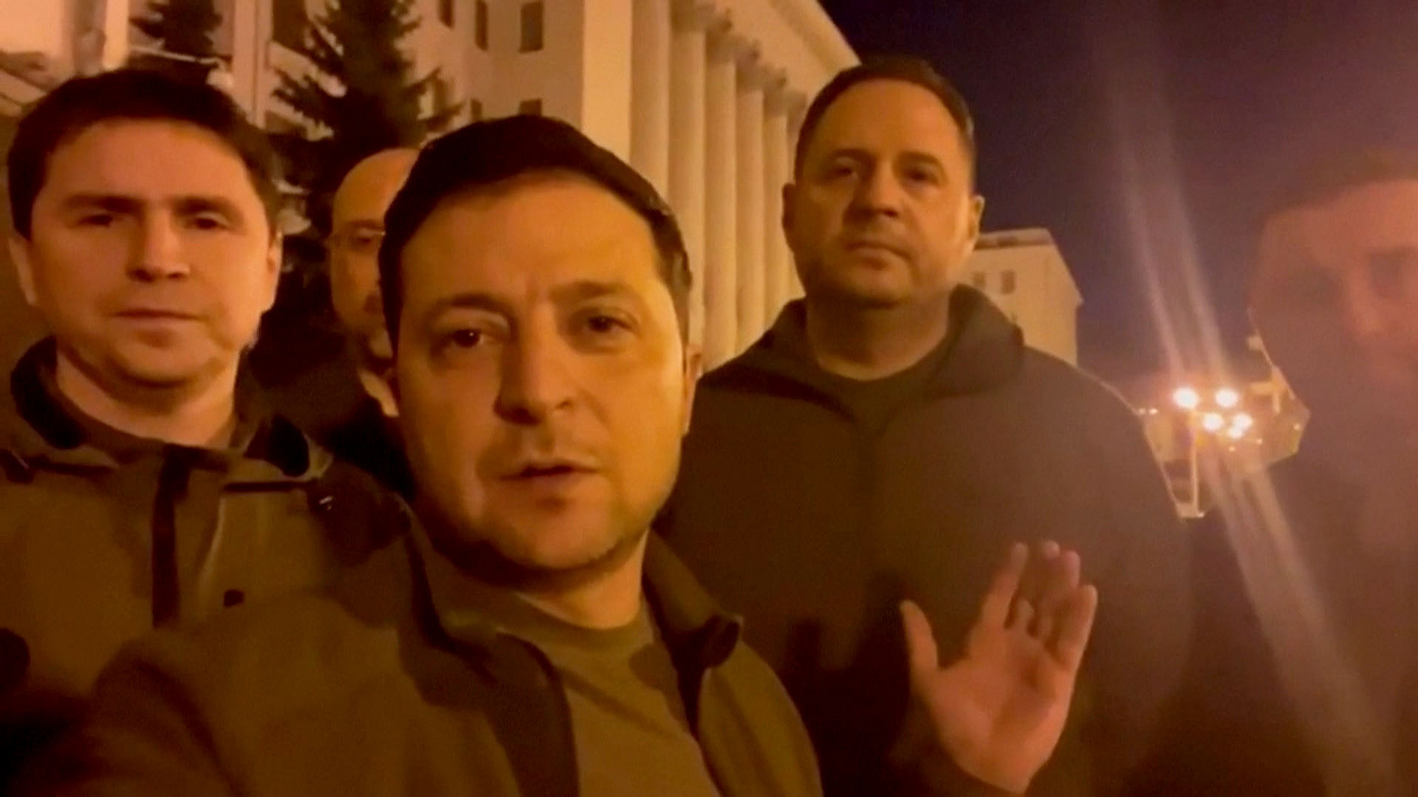
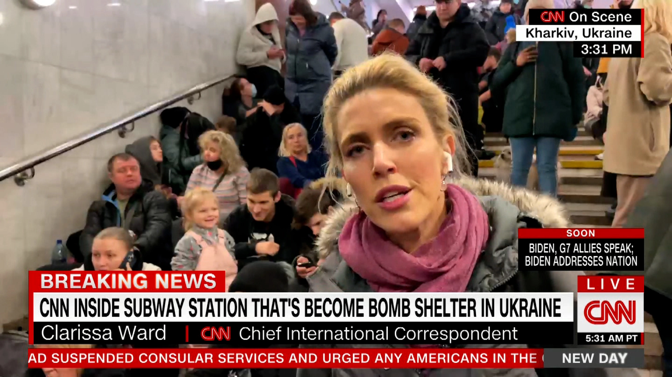
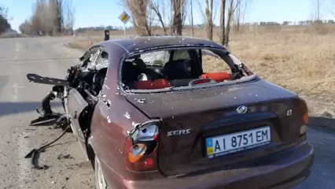
Ukraine stayed online
…the Ukrainian government to rally global support.
… news organizations to cover the war.
… Ukrainians to show the world what was happening.
Critical for

Slide 31
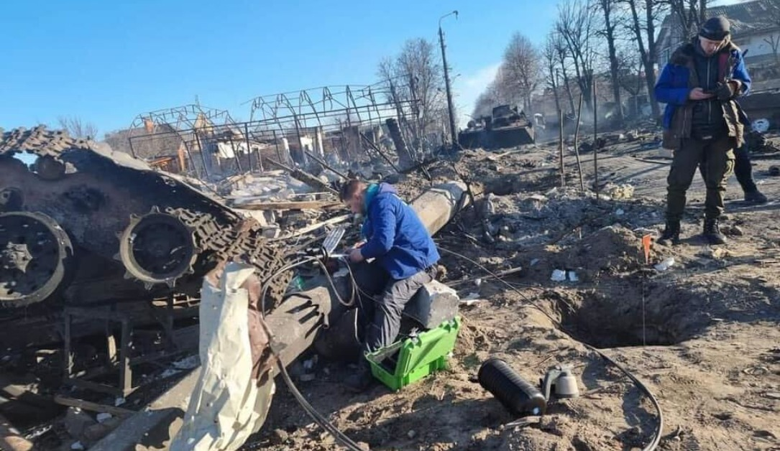
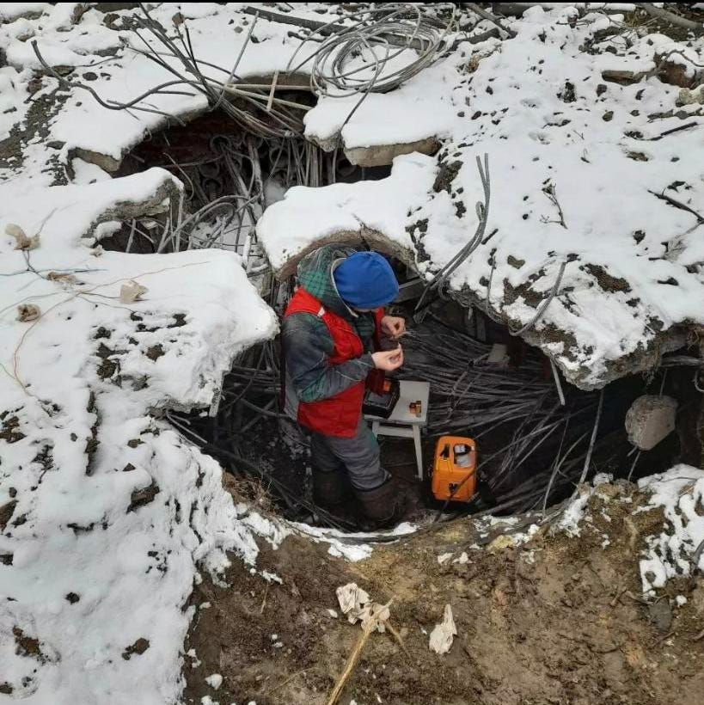
Ukraine stayed online
… due to the efforts of these heroes of the Internet

Slide 32
On-going war is largest in Europe since WWII
What does this means in the Internet age?
DDoS attacks against high-profile targets in both Ukraine and Russia
ISP outages in Ukraine due to destroyed fiber lines, cyberattacks.
Heroic efforts to repair broken lines by Ukrainian technicians.
Blowback effects in Russia
Social media and news blockage in Russia
Possibility of Internet-level sanctions
Assimilation of occupied areas
Wholesale cutover of transit for an entire occupied city (Kherson)

Slide 33
Тримайте Україну на зв’язку Support the Keep Ukraine Connected effort!
Doug Madory
dmadory@kentik.com
Twitter: @dougmadory

